Slide 1
The space boys and girls
Group 3- Talise , Ynobe , Jose, Chasity, Makayla and Raheem

Slide 2
ask
WHAT IS THE PROBLEM?
WE ARE DESIGNING A SPACE CONTAINER TO SELL TO THE ASTRONAUT.
WHAT DO WE ALREADY KNOW?
IT CAN NOT BE VERY LARGE.
WHY ARE WE BUILDING THE SPACE CONTAINER?
TO GET PRACTICE LEARNING HOW TO USE THE ENGINEERING DESIGN PROCESS.

Slide 3
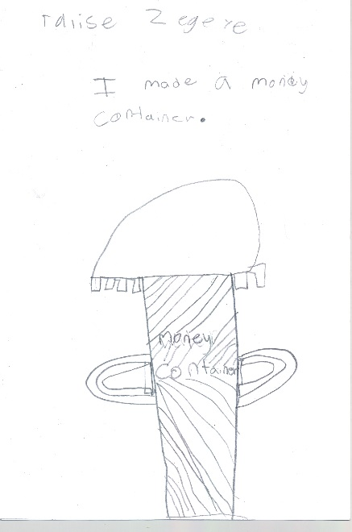
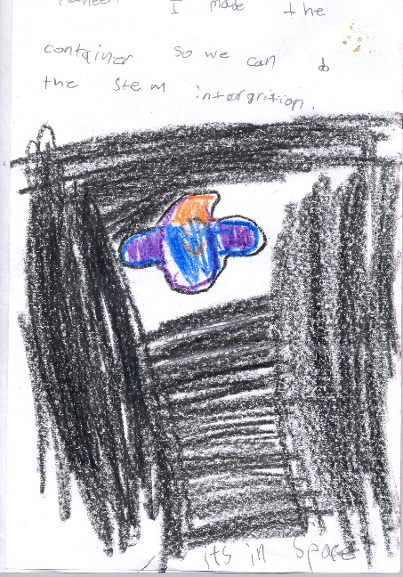
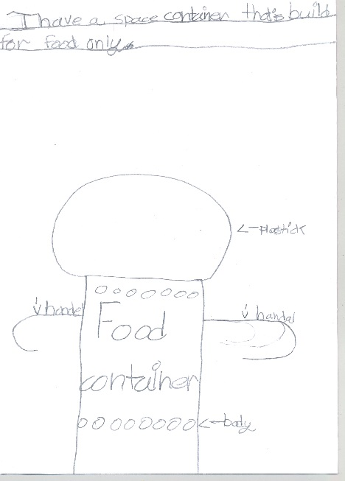
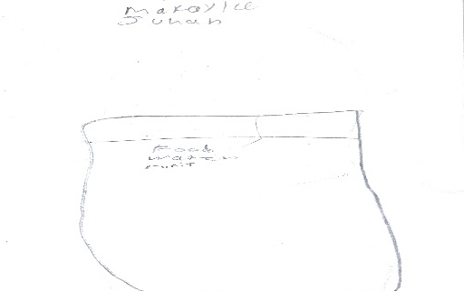
imagine
I IMAGINE IT LOOKS LIKE DIFFERENT SHAPES.
I IMAGINE IT LOOKS LIKE A CUP WITH HANDLES.
I IMAGINE IT LOOKS LIKE A CUP WITH A FACE.
I ALSO IMAGINE IT LOOKS LIKE A CUP WITH A SHEIED.

Slide 4
plan
WHaT supplies will we need ? PLASTIC
PLASTIC , TAPE , PLASTIC CUP , GLITER GLUE

Slide 5
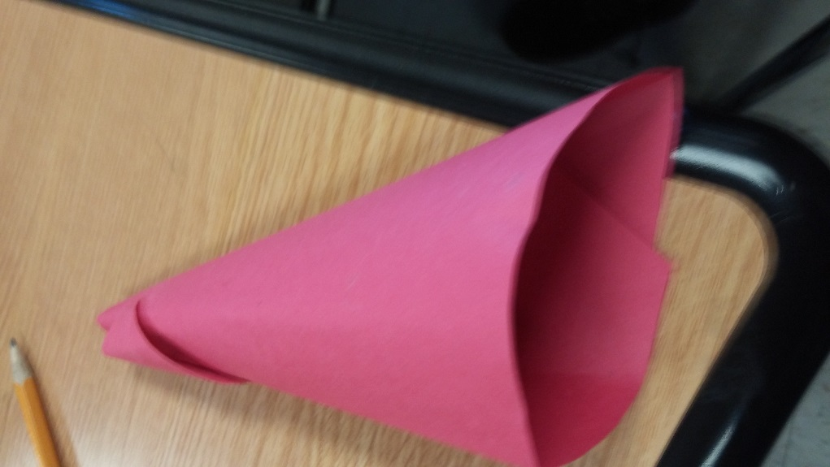
create
WE rolled a piece of paper and made a cone .
WE ROLLED A PIECE OF PAPER AND MADE A CONE.
We taped the top and side of the cone. Then we used the scissors to even the bottom.
Once we pressed the side down ,the cone looked like a triangle.
We closed in the bottom by folding it ,and decided we could store in it for the astronauts.

Slide 6
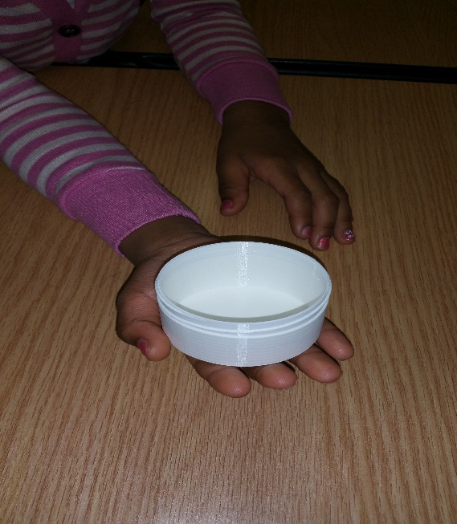
Improve
To improve the container we used aluminum foil and 3-D printing as our new materials.
We used 3-D printing so astronauts can design their own containers in space.

Slide 7
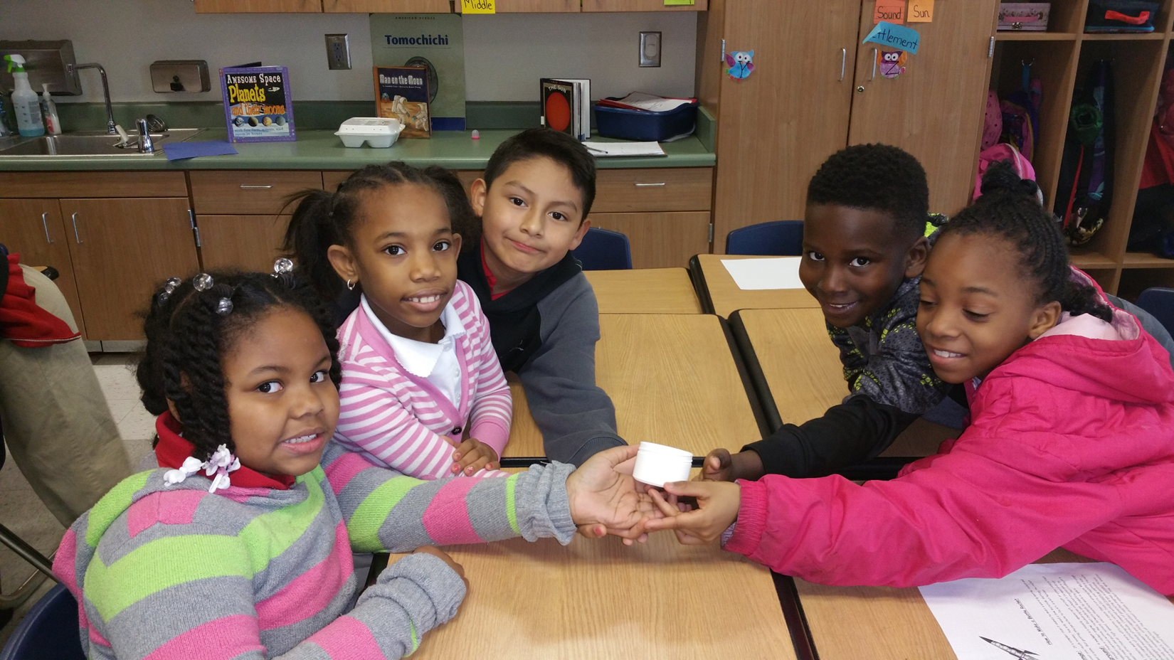
present
All of the members of the group will present.

