Slide 1
STAR ROCKET
Group1-Summer, Alieson, Jade, Devin, Jasiya and Jerod

Slide 2
Ask
1. What do we already know?
Astronauts have very little space.
2. What is the problem?
They need lots of containers for everything.
3. What are our limits?
Nothing can stop us.

Slide 3
imagine
What would a container that can be used in space by astronauts look like?
It would look like a container with tools.
A cup with handles.

Slide 4
plan
What supplies will we need?
We are going to use tape, glass, plastic straws, containers and foil.
Who will do the job?
Devin, Summer, Alieson, Jade, Jerod, Jy’lah

Slide 5
Create
We used a cone and tape.

Slide 6
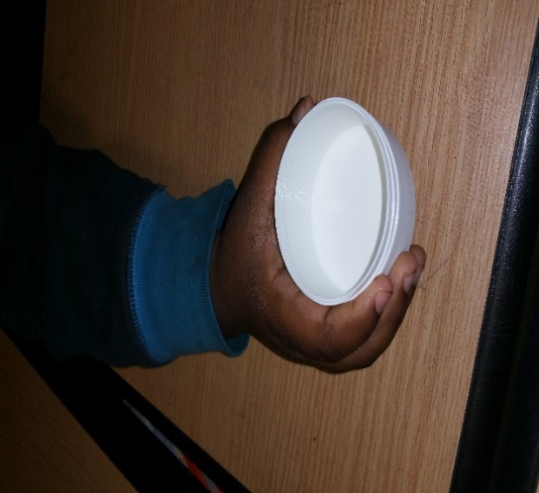
Improve
To improve the container we used aluminum foil and 3-D printing as our new materials.
We used 3-D printing so astronauts can design their own containers in space.

Slide 7
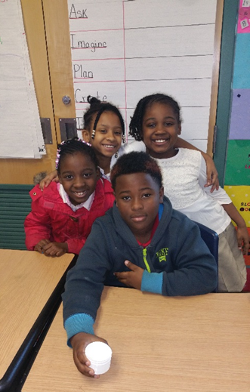
present
All of the members of the group will present.

