Slide 1
Star Nation
Group 4- Naudia Sanders, Keani Rouzan, Kenya Harris, Marco Harris, Kamyah Reid and Skyler Worthey

Slide 2
Ask
What is the problem?
The problem is that the astronauts need more containers for everything.
We already know:
We know what we need to build a space container.
What are our limits?
We had limited materials.

Slide 3
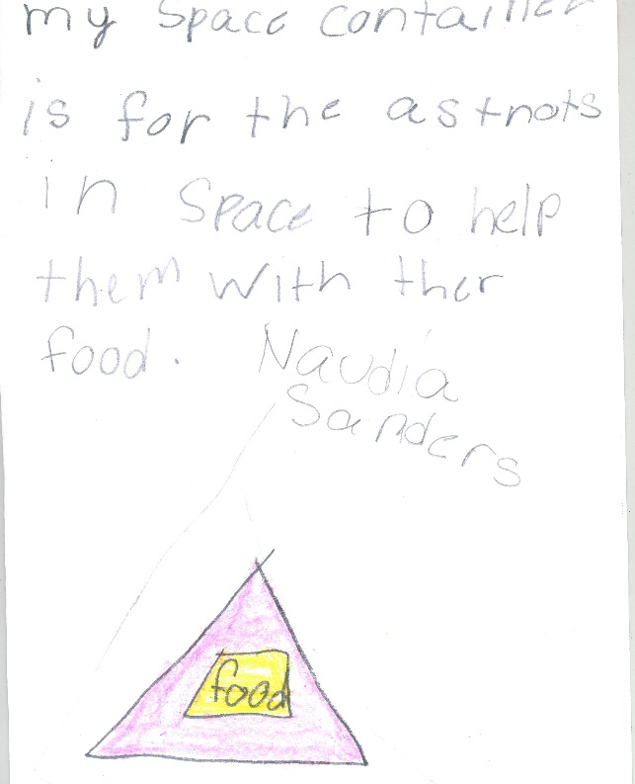
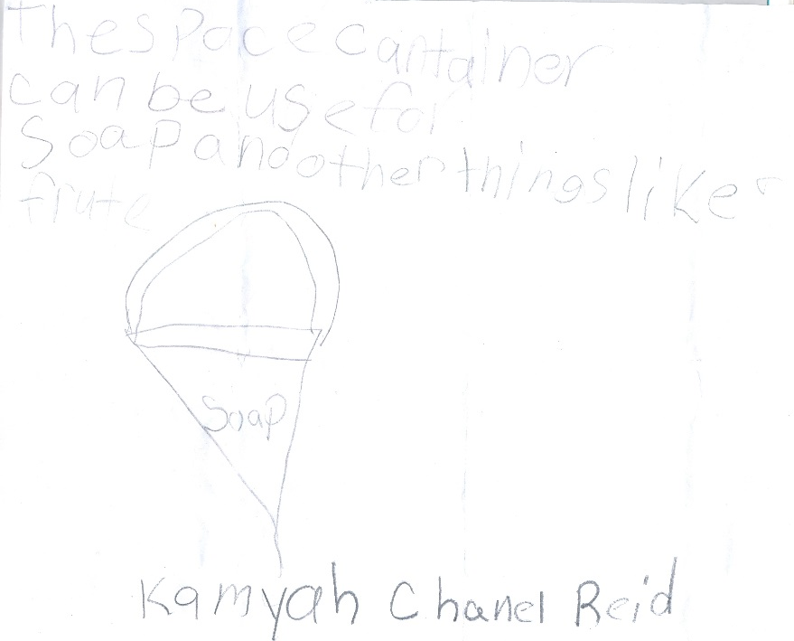
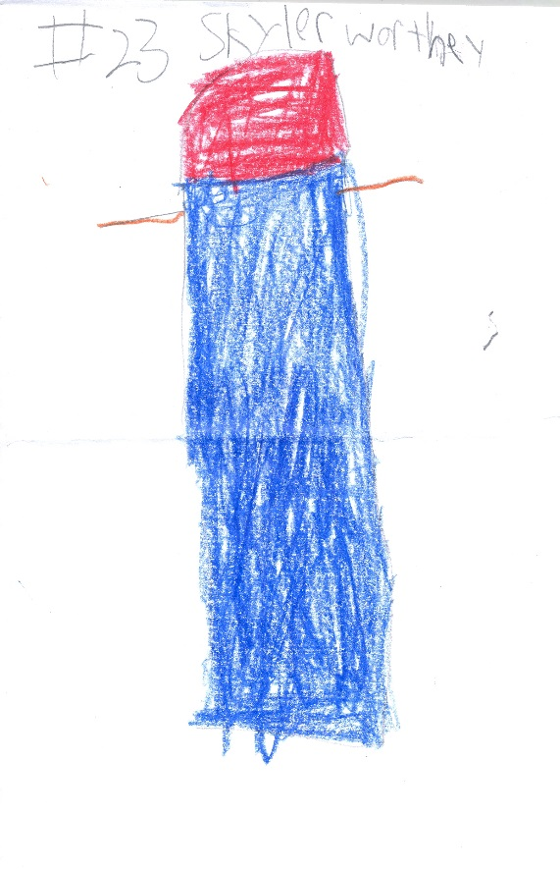
imagine
What would a container that can be used in space by astronauts and on earth by people look like?
It looks like a triangle, cone and a rectangular prism.

Slide 4
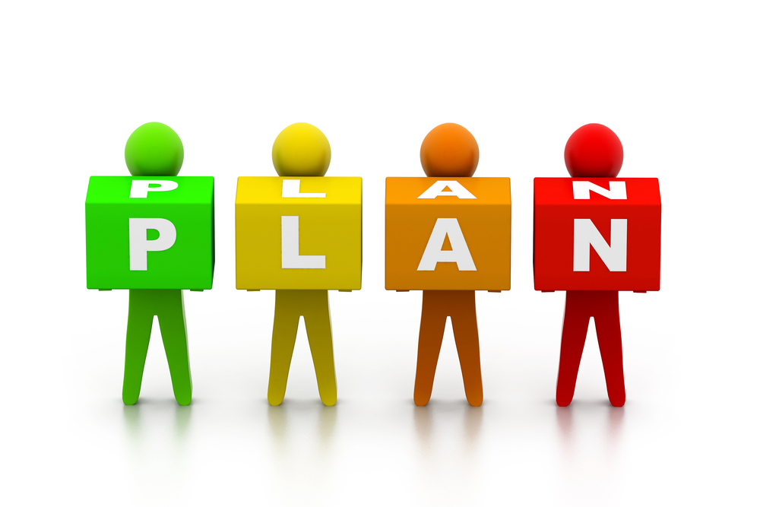
plan
Our plan is to build a space container:
With tin foil and duck tape.
Tape and paper and little bottles of water and tubes and we need sticky notes.

Slide 5
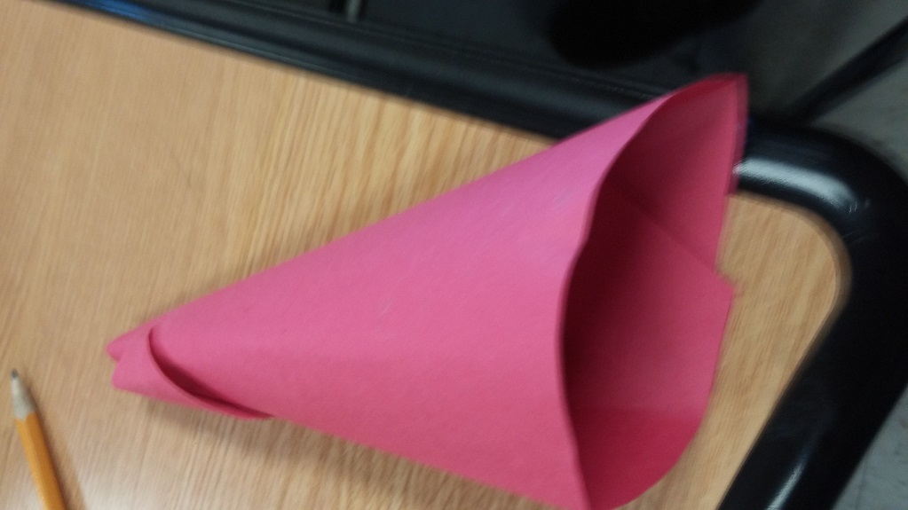
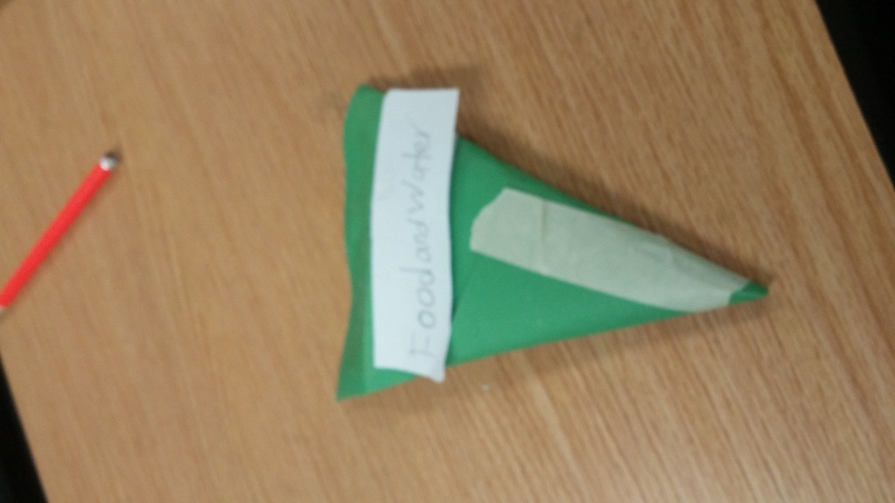
create
We rolled a piece of paper , and made a cone .
We taped the top and side of cone. Then we used the scissors to even the bottom.
Once we pressed the sides down , the cone looked like a triangle.
We closed in the bottom by folding it , and decided we could store food in it for the astronauts.

Slide 6
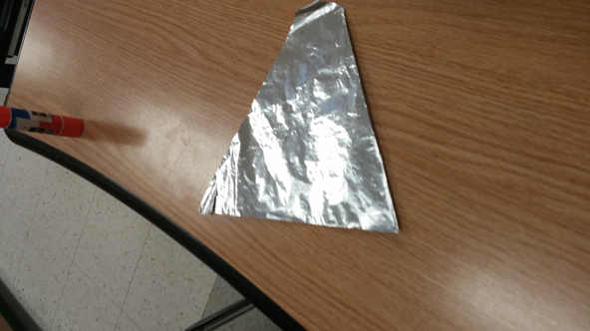
Improve
To improve the container we used aluminum foil and 3-D printing as our new materials.
We used 3-D printing so astronauts can design their own containers in space.

Slide 7
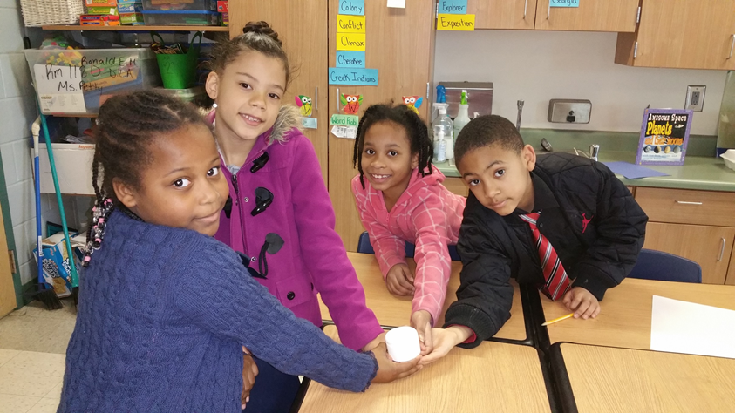
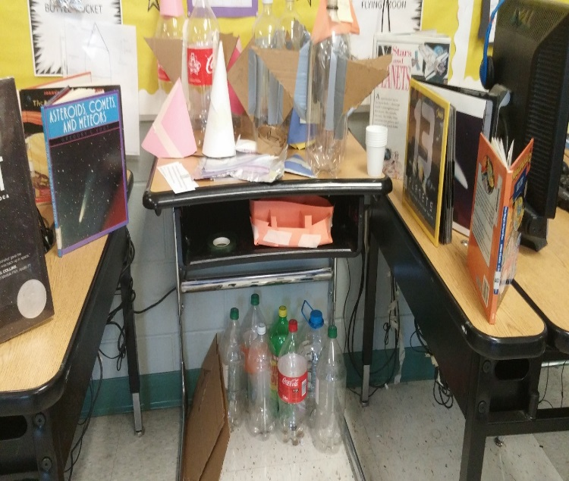
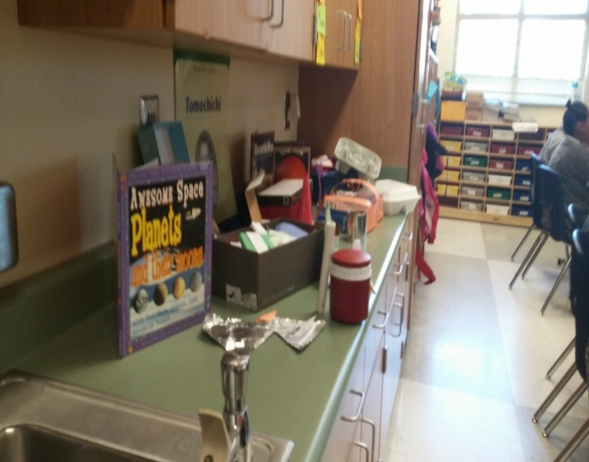
present
All members of the group are expected to share in the presentation.

