Slide 1
Shining Stars
Group 2: Keondre Roberts ,Micah Neal, Jy’lah Lemons, Janae Johnson, Makenzie Taylor and Xzariya Woodruff

Slide 2
ASK
What is the problem ?
How will the space container look like.
To see how it will be used.
What we already know?
It cannot be very large.
What are our limits
We need to make space container very small

Slide 3
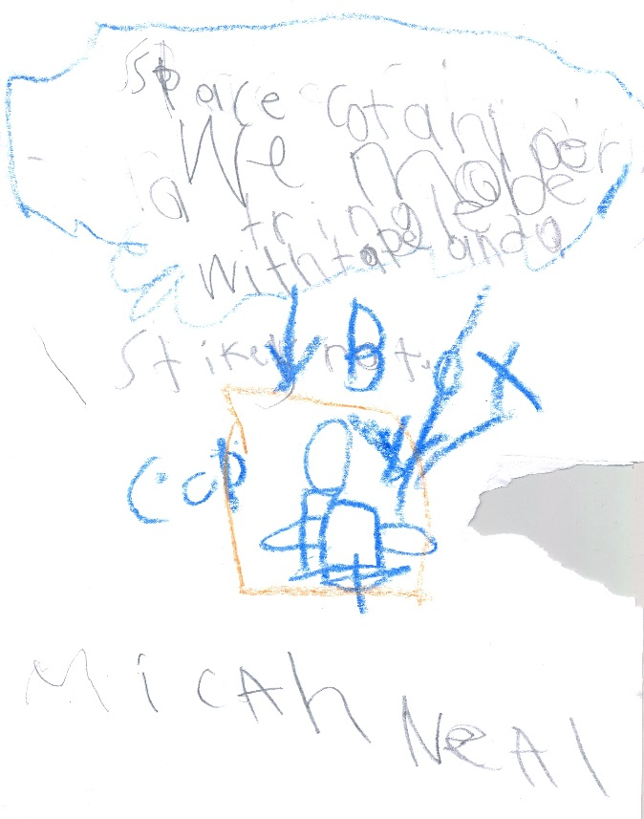
imagine
A space container could look:
A cup with handles
A square , a triangle, or a rectangle
A bag with a straw in it

Slide 4
plan
Materials to be used:
Ziplock bag
Tape
Scissors
The people that will do the jobs are Micah, Jasiya, Makenzie, Janae, Keondre, Xzriaya.
Draw a diagram.

Slide 5
create
.We rolled a piece of paper, and made a cone.
.We taped the top and side of the cone. Then we used the scissors to even the bottom.
.Once we pressed the side down the cone looked like a triangle .
.We closed it in the bottom by folding it, for the astronauts.

Slide 6
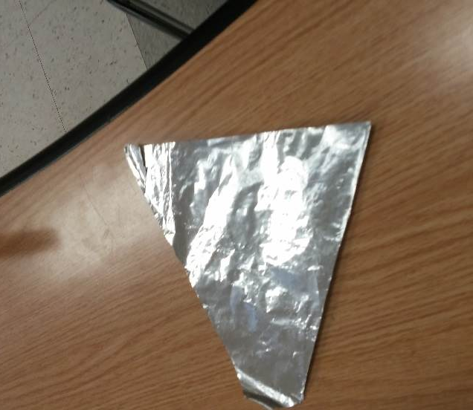
Improve
To improve the container we used aluminum foil and 3-D printing as our new materials.
We used 3-D printing so astronauts can design their own containers in space.

Slide 7
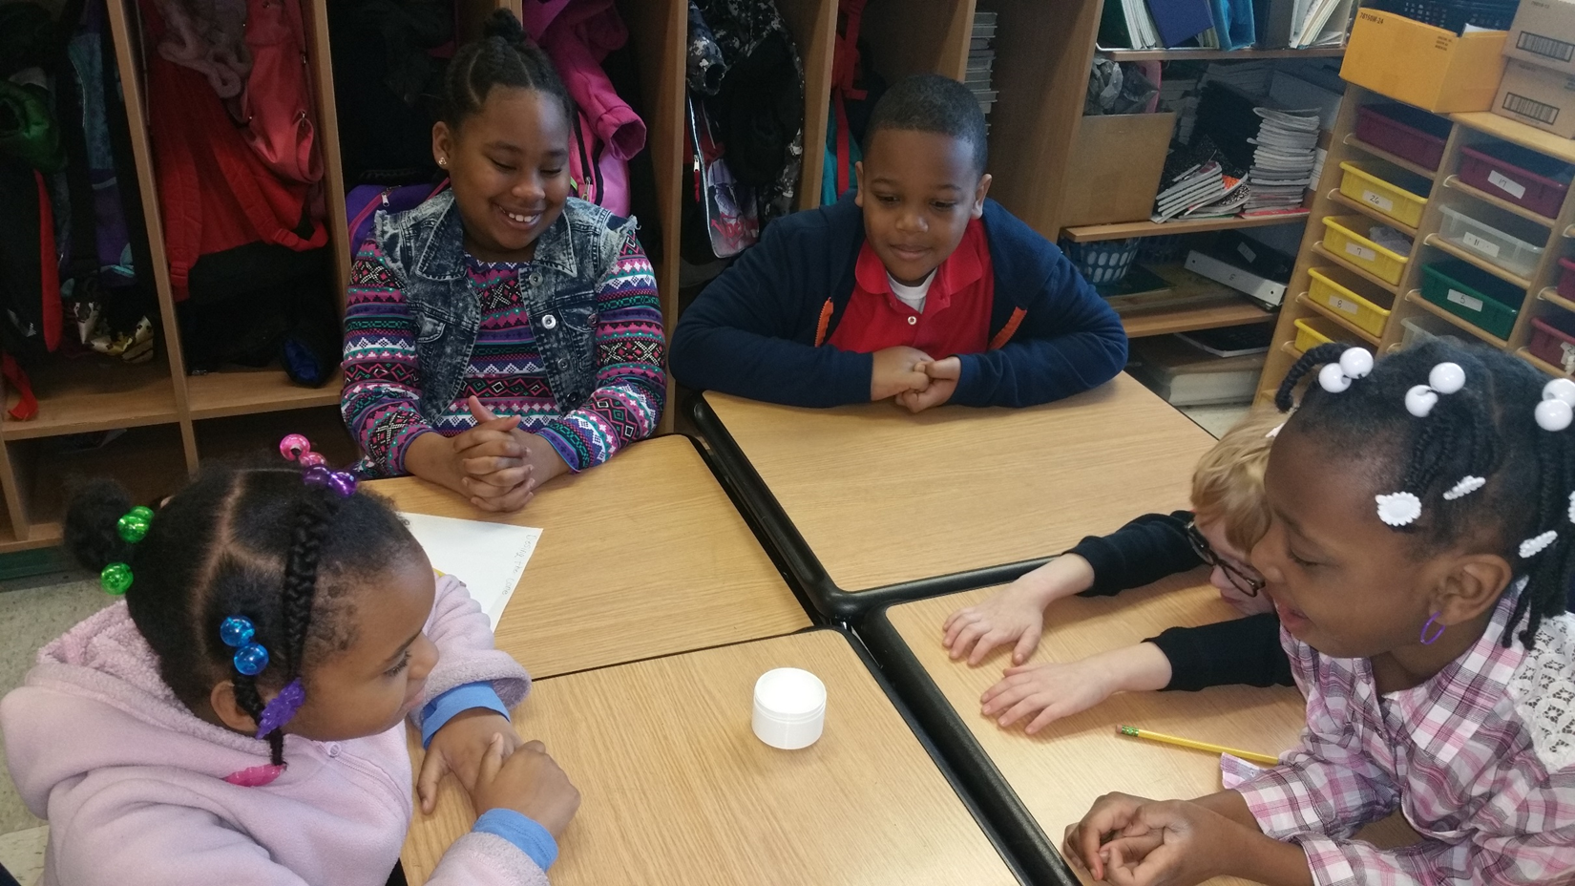
present
All of the members of the group will present.

