Slide 1
smart third graders excited about math
3RD GRADE AQUIFERS
Alexander Strickland
JORDIN huff
DAMALI Dixon
JAVANTE wright
-

Slide 2
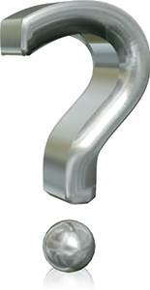
ASK
WHAT DO WE ALREADY KNOW?
WHAT IS THE PROBLEM?
WHAT IS THE SOULOUTION?
Why do we need a aquifer?
What are the controls and limits?
What type of rock will filter the lead?
Why are we building a aquifer?

Slide 3

imagine
my group and I think its going to look like a mini pipe with a bunch of water transferring through the inner part of the pipe dirty water to clean water to the places that are in need of clean water.

Slide 4
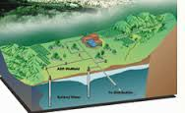
plan
Materials: sand , gravel , clay , dirt , several plastic cups that have a hole poked into
The bottom like this , water in a cup , bowls that are slightly larger than the cups.
fill the cup with a material (sand , gravel , clay , or dirt ) and pour water in the top repeat this trying out each material figure out witch is the most permeable meaning water flows through easily in witch is least permeable water doesnt flow through it and it slow through it and get stuck in the cup).

Slide 5

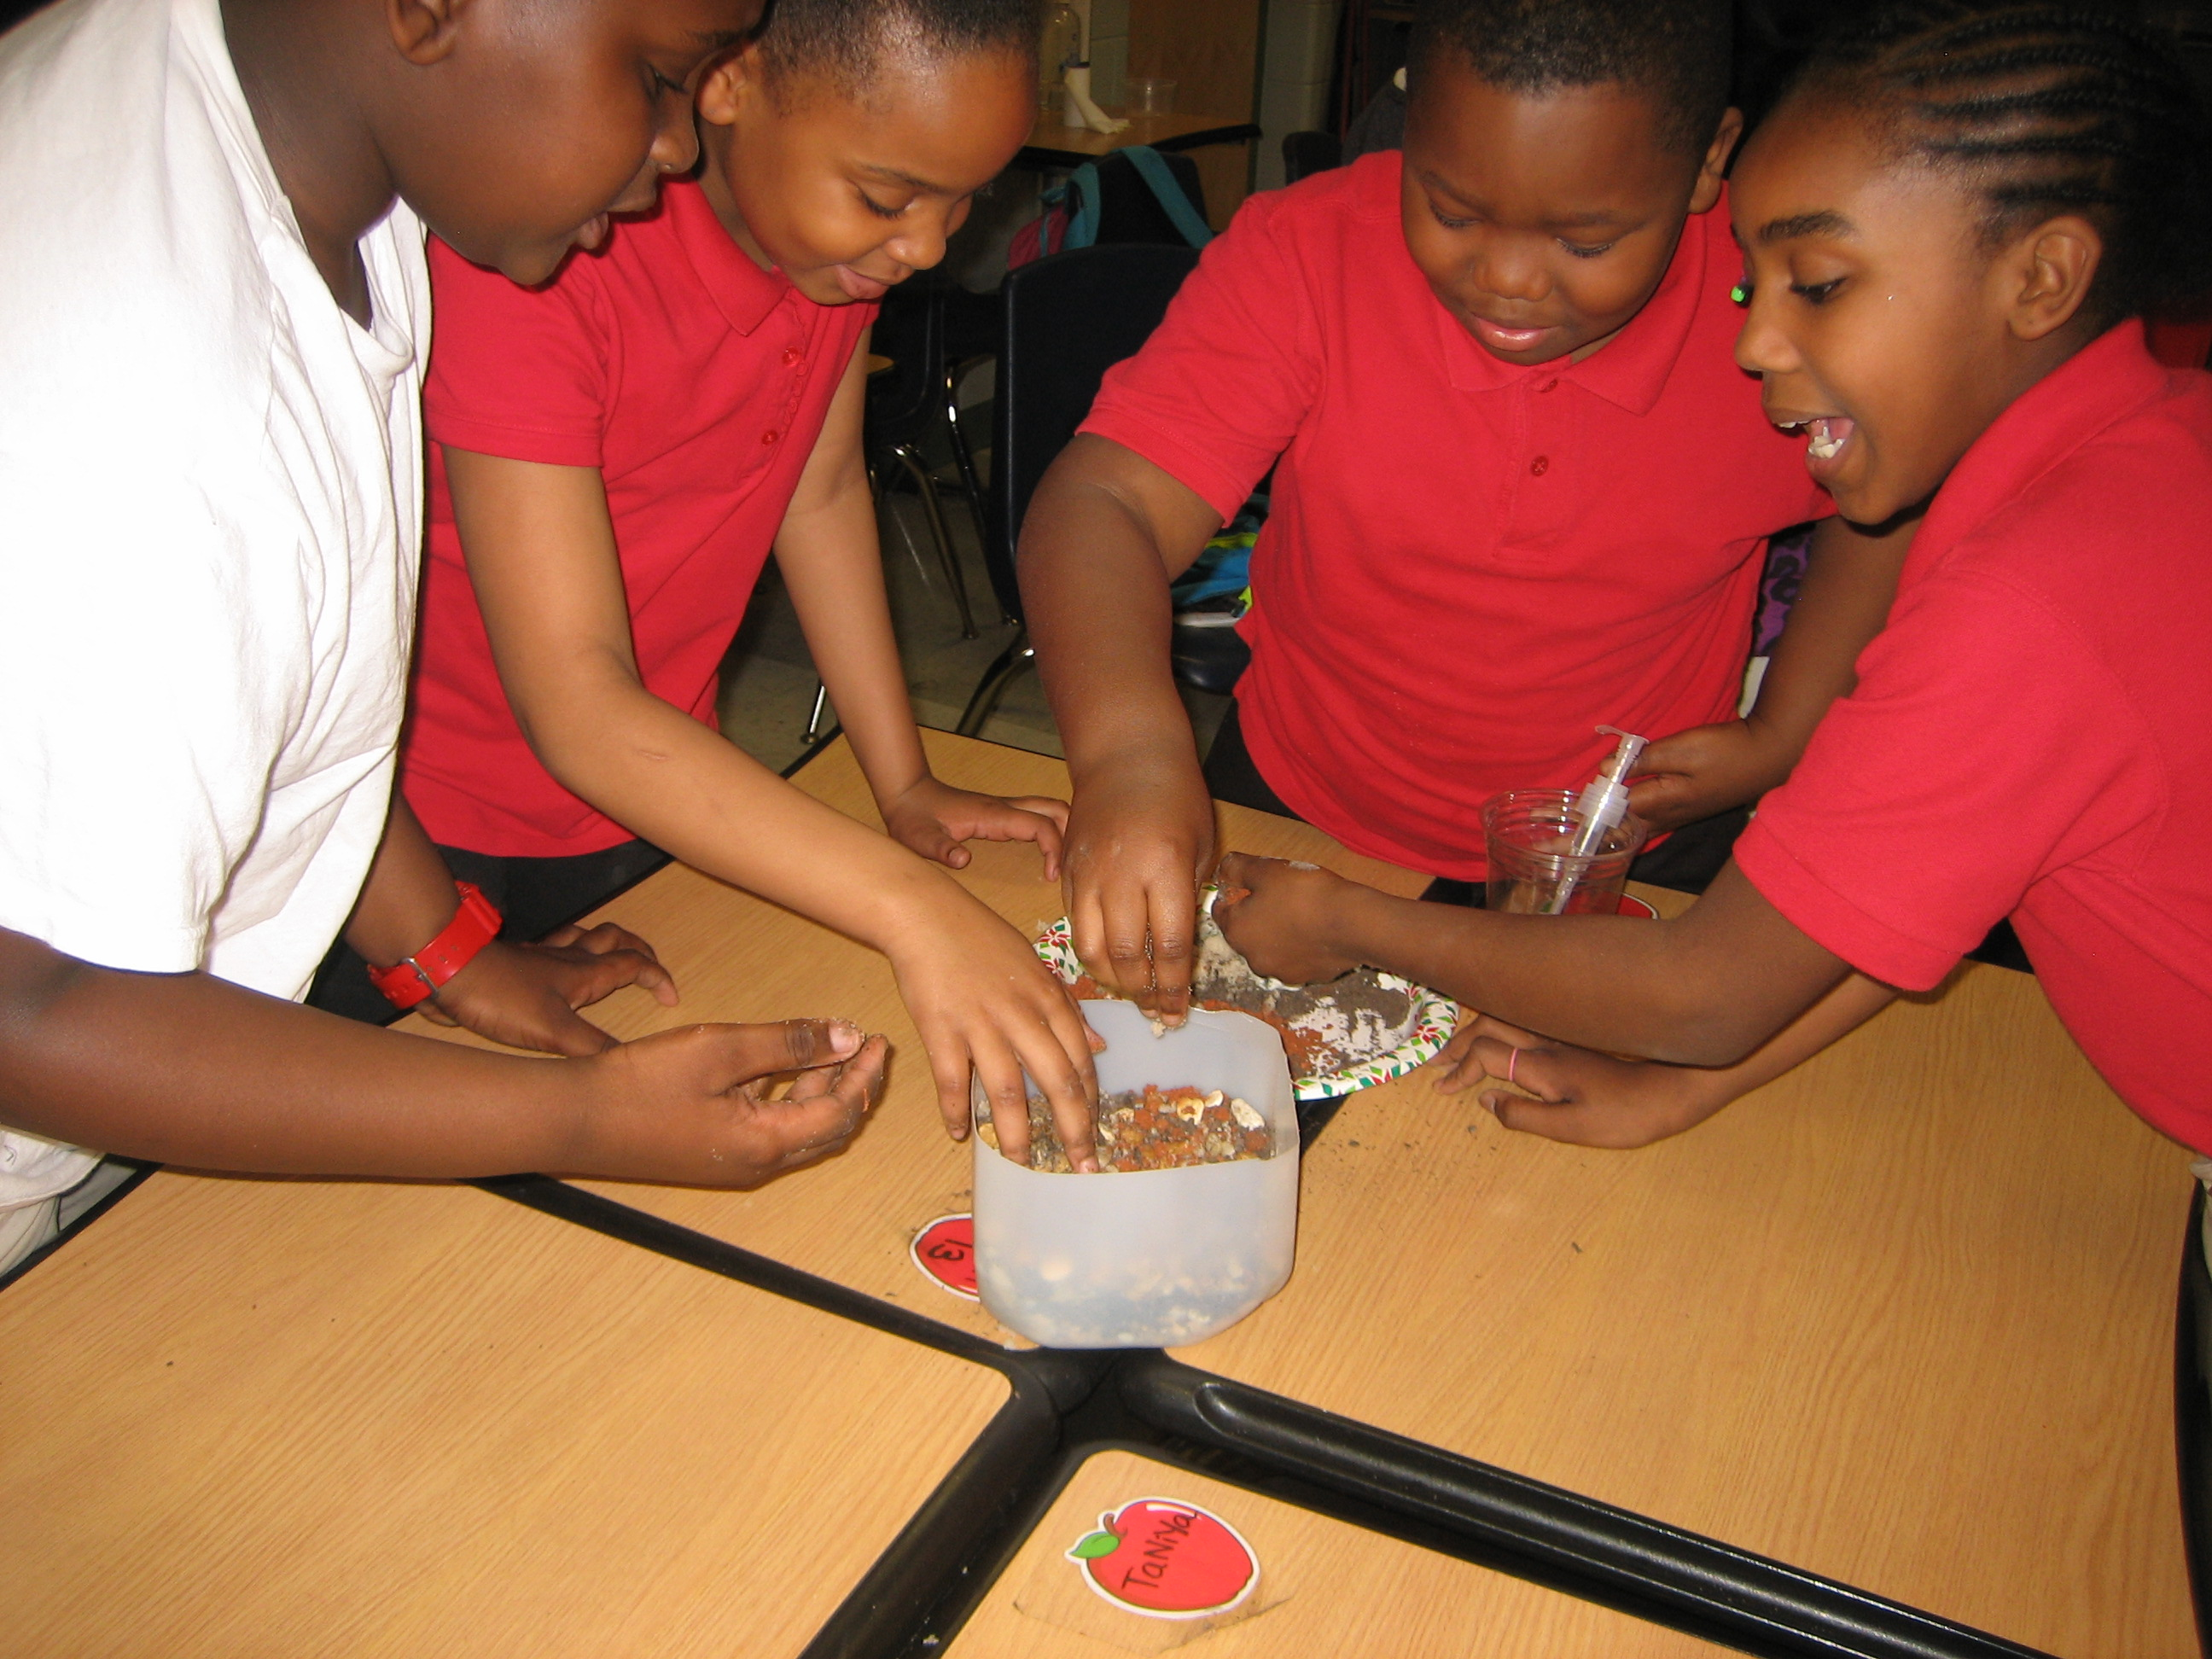
create

Slide 6
improve
Make the rocks I hill form to make the aquifer better.
Not the right type of rock.
Learn to cooperate with one an another.
the pan that we used was to small to work with.
Also needs to be layird correctly .
Don’t mix all the supplies together.
Don’t pile up all the rocks .
We used to much dirt.

Slide 7
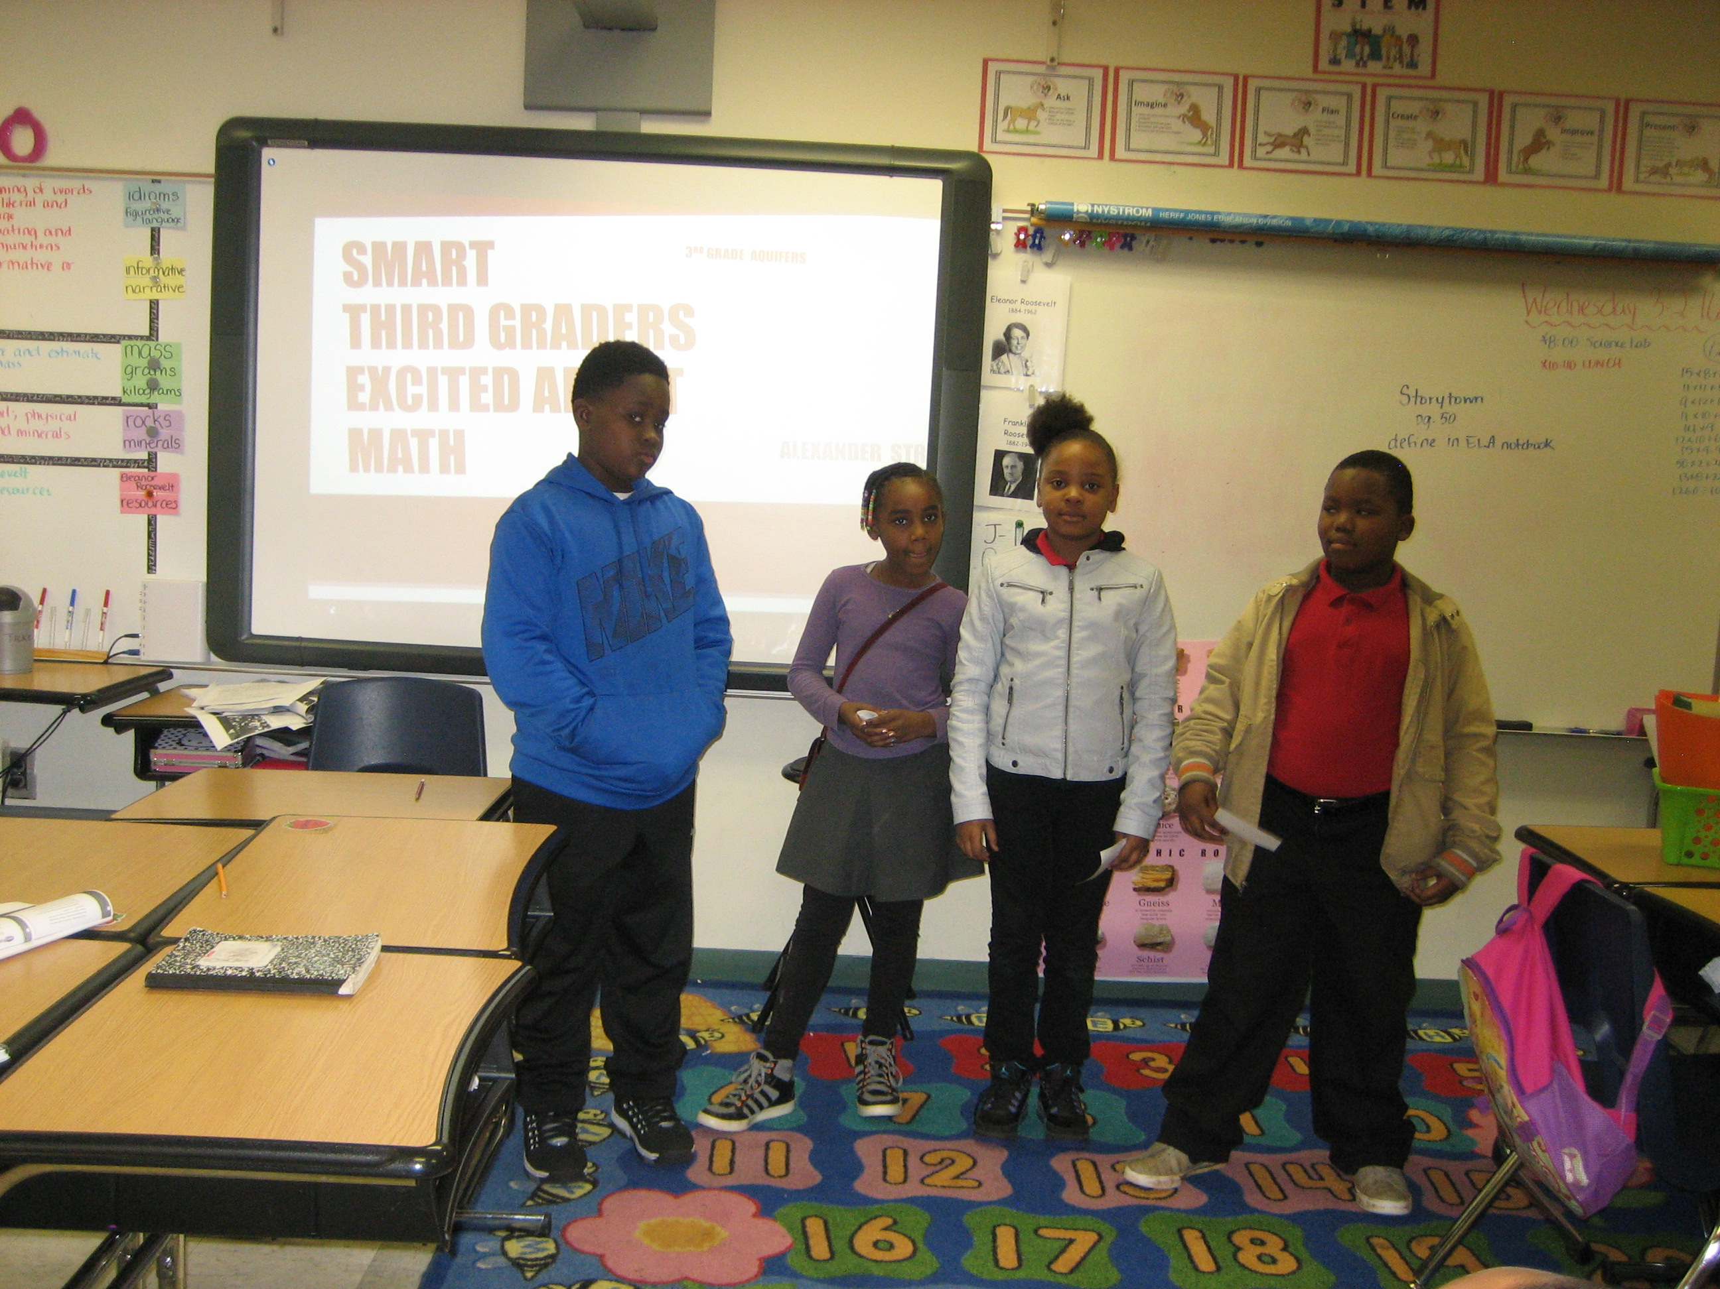
present

Slide 8
Re-ask
1. What are the controls and limits?
2. Will our water filter work?
3. Do we have the right materials?
4. How can we fix the problem?
5.

Slide 9
Re-imagine
Since the aquifer didn’t work, now we are building a water filter using new materials. We are going to use
coffee filters, gravel, fine sand, and coarse sand. We are going to use a 2-liter bottle upside down.

Slide 10
materials
2 liter bottle
1 cup of Small pebbles
2 cups of Fine sand
2 cups of Coarse sand
3 Rubber bands
3 coffee filters
Cup for clean water

Slide 11
resources
https://eo.ucar.edu/kids/wwe/ground4.htm
http://imnh.isu.edu/digitalatlas/hydr/concepts/gwater/aquifer.htm
http://www.safewater.org/PDFS/knowthefacts/Aquifers.pdf

Slide 12
rubric

