Slide 1

Skillful
Third graders
Excitedly
Motivated
By purple basket
Chase Pope, Joy Moreland, Edgar Hernandez-Blanco, Ayanna Gist-Wesley

Slide 2
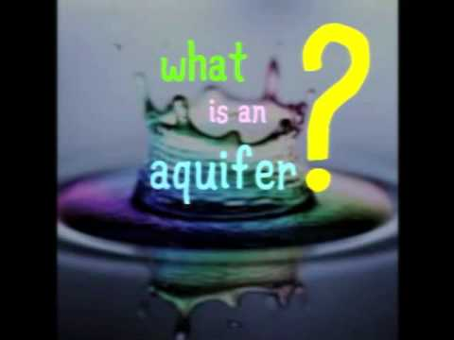
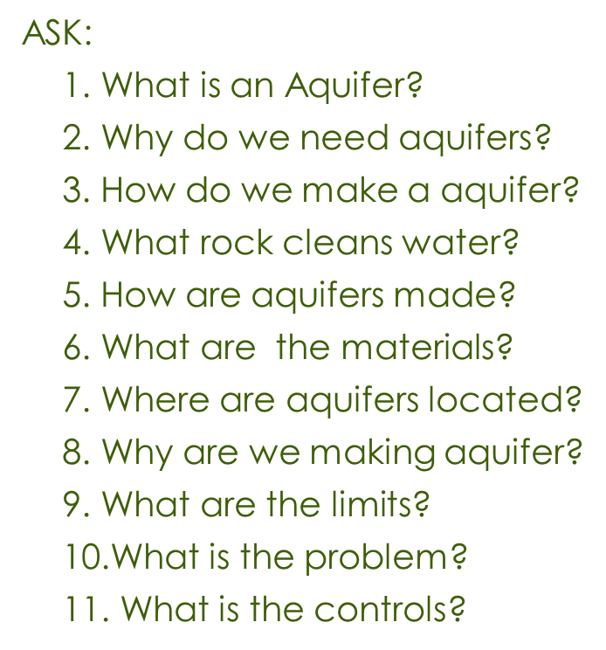

Slide 3

Imagine
By using the rocks to clean the water .
we are trying to clean water because kids are getting sick from dirty
Research to find out more about aquifers
Trying to filter out the lead from the contaminated water
People in third world countries and Flint, MI are getting sick from drinking the polluted water

Slide 4
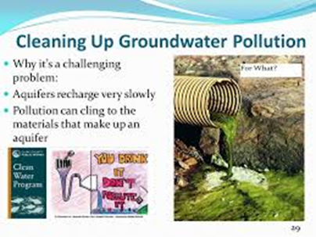
plan
1. Cut the coke bottle in half
2. Put the soil and sand on the half of the coke bottle.
3. Put rocks and gravel then put the dirty water.
4. Make hole on the cup with the pin.
5.Then put the food coloring.

Slide 5
materials
Ruler
Sand
Rocks
Scissors
2 liter Coke bottle
Pin
Dirty water
Soil
Plastic cup
Food coloring

Slide 6
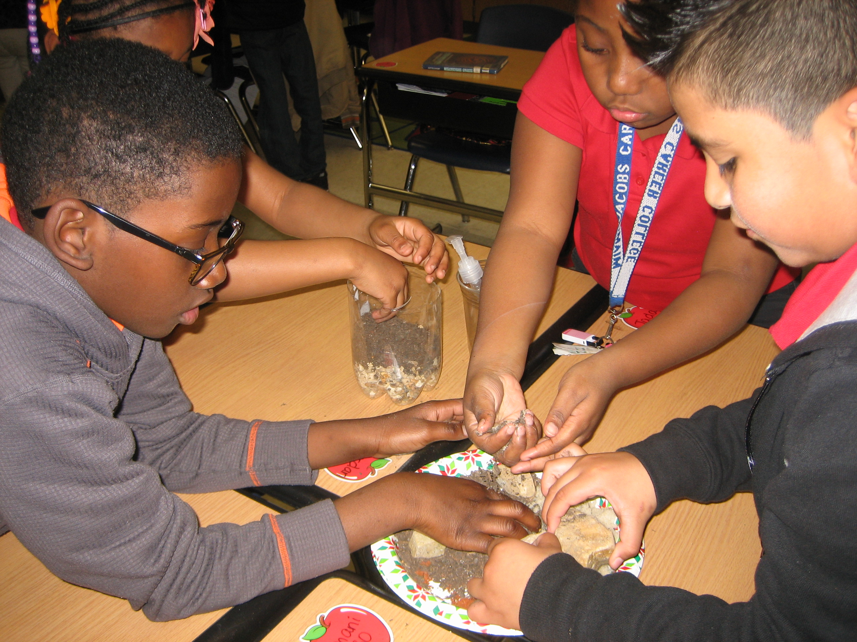
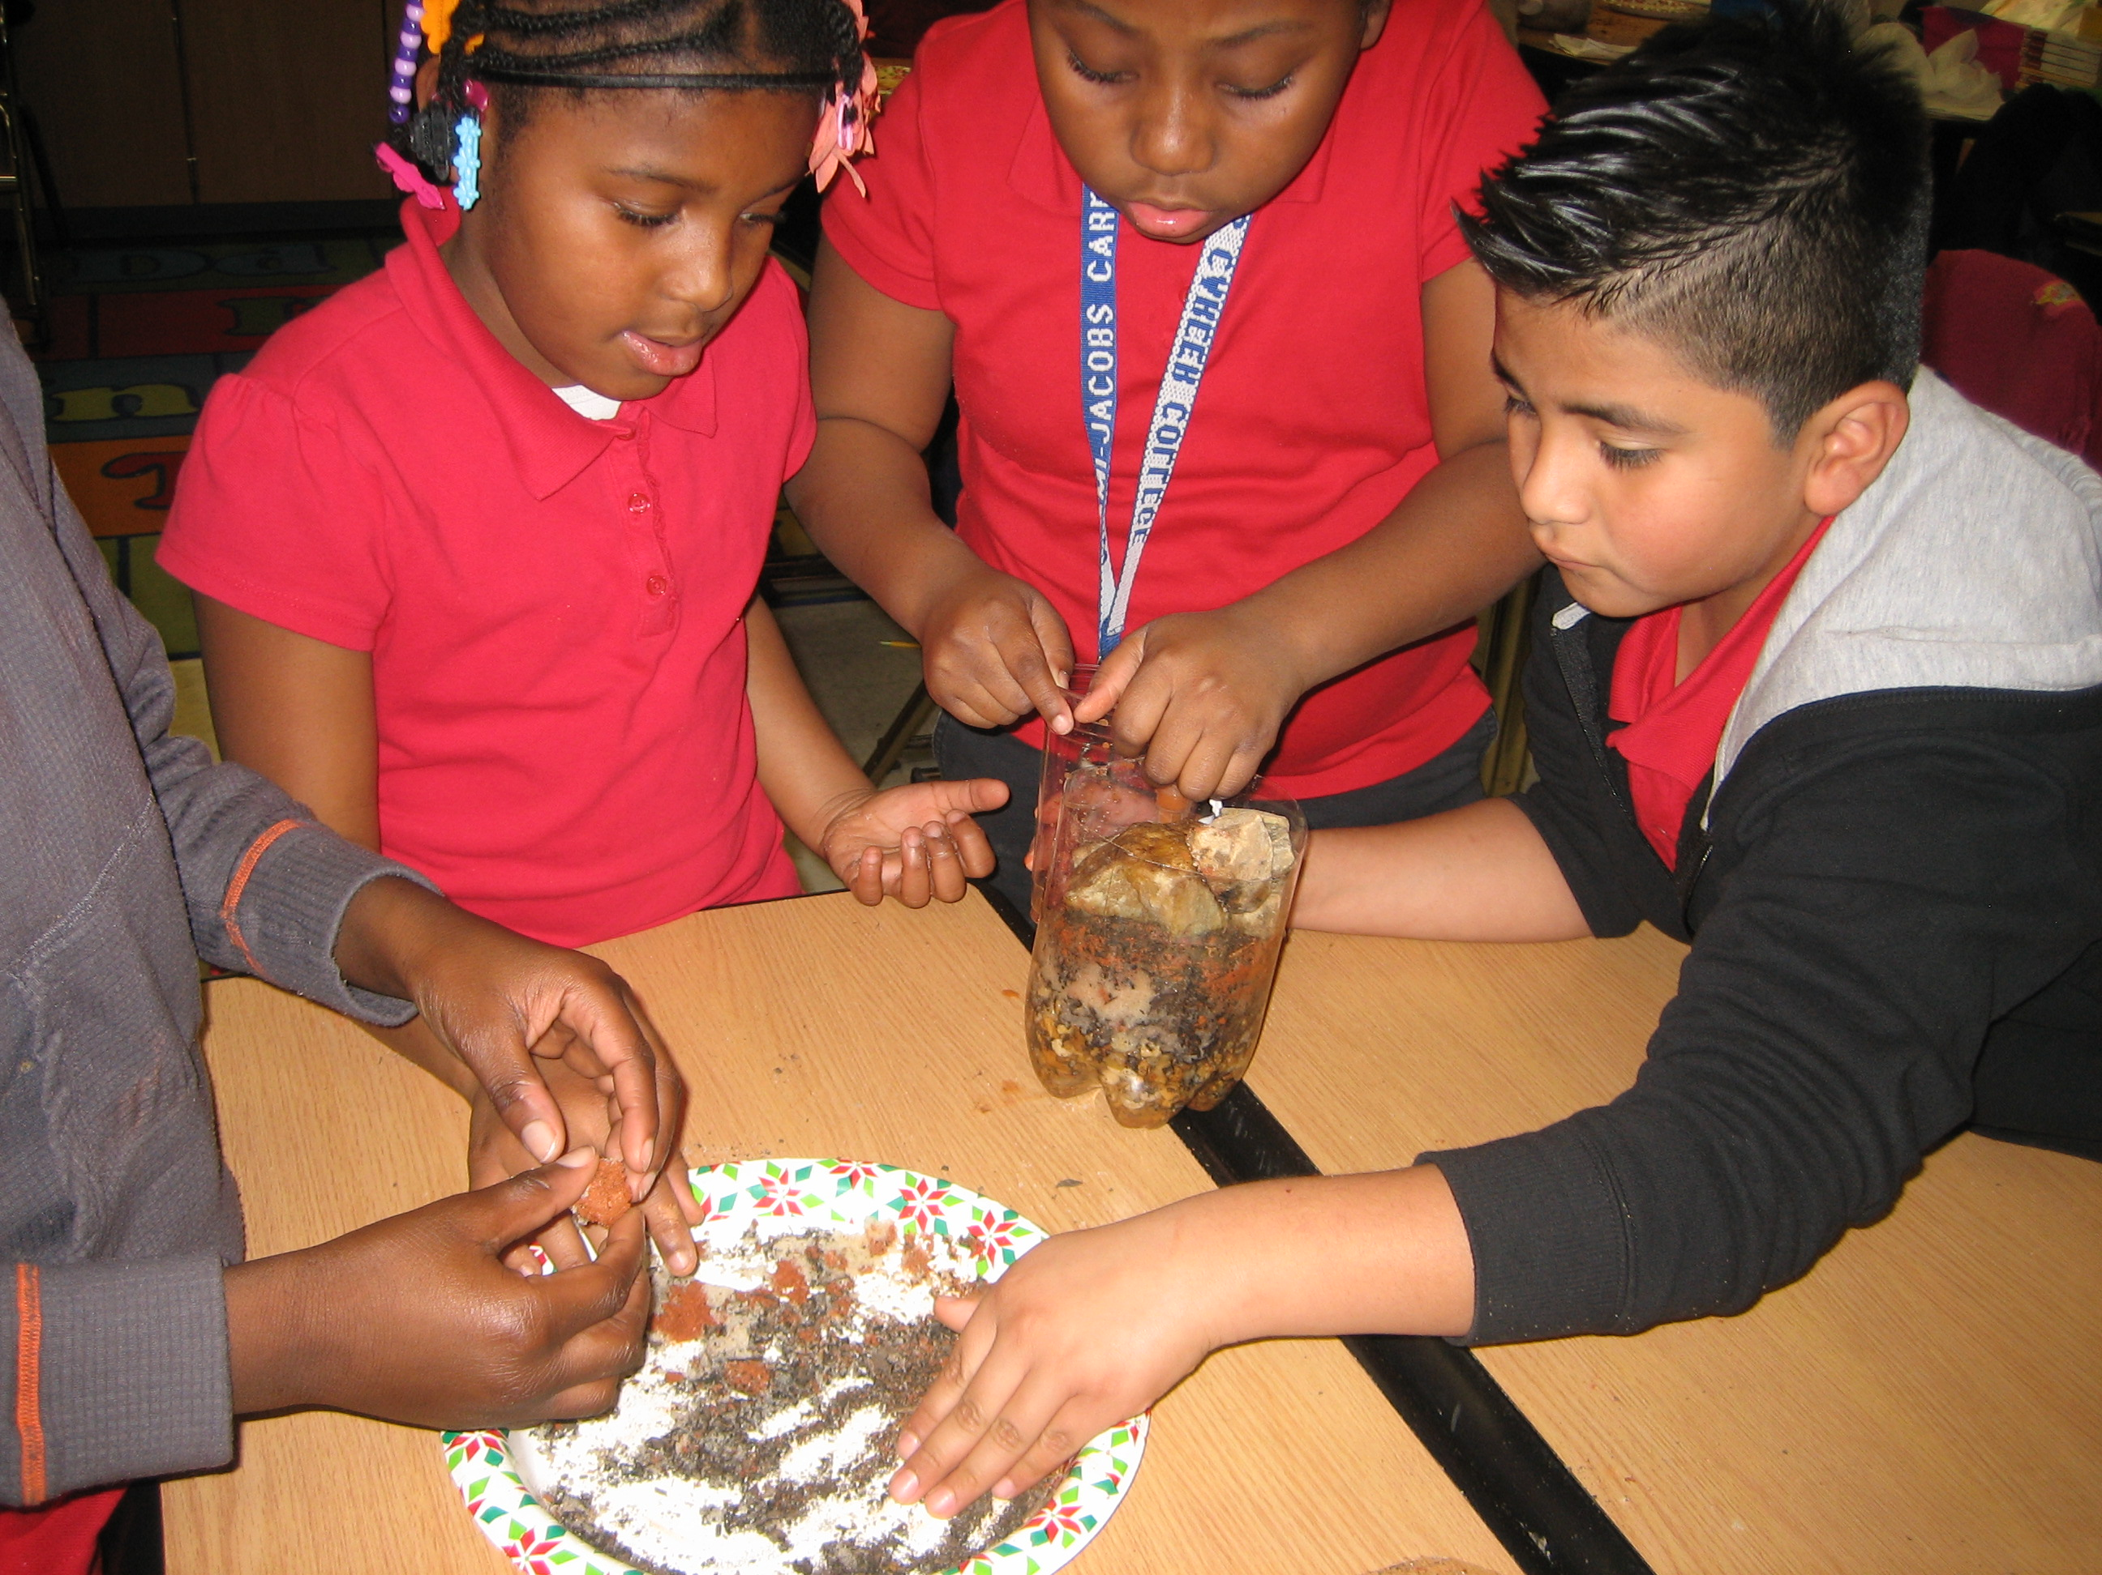
Create

Slide 7
Improve:
1. Pay attention to layers.
2. Make a hill.
3. Get the right rocks.
4. Make sure it’s the right amount of dirt.
5. Bowl not large enough.
6. Put in group effort.
7. Make sure the tube is not clogged.
8. Make sure the right materials are in order.
9. Get along with group members.
10. Make sure water is clean.
11. Put in order.

Slide 8
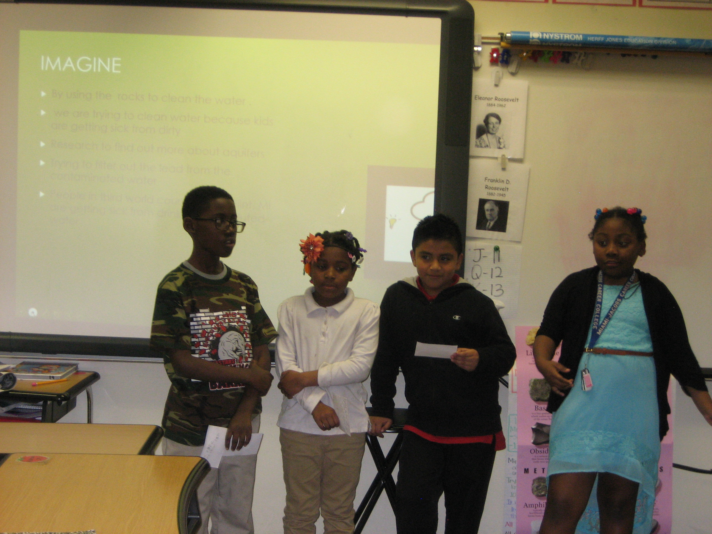
Present:

Slide 9
Resources:
http://www.aquariumofpacific.org/downloads/IAFTM_AquiferLesson.pdf
2. https://eo.ucar.edu/kids/wwe/ground4.htm
3. https://en.wikipedia.org/wiki/Aquifer

Slide 10
Rubric:

