Slide 1
Smart
Third graders
Educate
More about aquifers
By: pink group
Michael Rader, Jordan Burns, Jada Clark, Chimera Dupree

Slide 2
Ask?
How is the water filter going to filter dirty water?
What are the limits and constraints?
What are the materials to build the aquifer?
Will the pump work?

Slide 3
Imagine
Clean water with rocks or minerals in a aquifer for people in the world who cannot get clean water to drink.
Since third world countries cannot get a water system(from a Walmart or Target) nor do they have any money.
Make a well with a water pump.

Slide 4
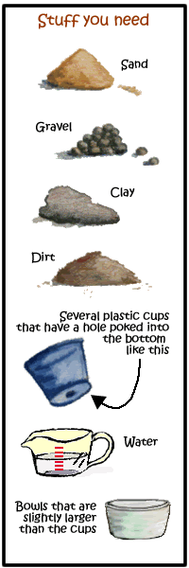
Plan
1. Fill the cup with a material (sand, gravel, clay, or dirt) and pour water in the top. Repeat this trying out each material to figure out which is the most permeable (meaning water flows through it easily) and which is the least permeable (water doesn’t flow through it and gets stuck in the cup).
2. Now that you know more about materials that are found in the ground, you are ready to make an aquifer! Choose the material that you found to be the least permeable and make a layer of it at the bottom of the cup. Then, fill the rest of the cup with the material that is the most permeable.
3. Does your aquifer actually hold water? Pour some in and see!
4. Fill the cup and see how much water you can trap in your aquifer!

Slide 5
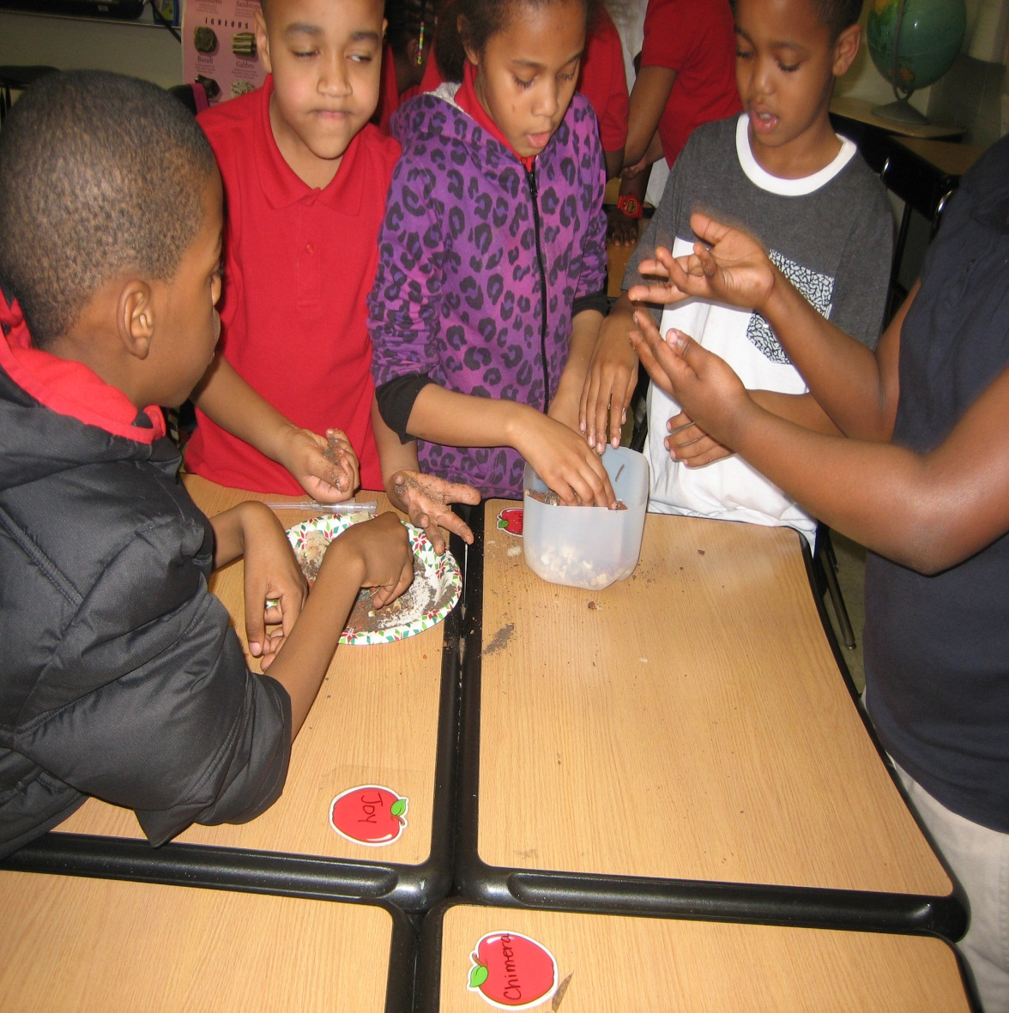
Create

Slide 6
Improve
1. The pan has not big to hold the water and the rocks.
2.We did not put rocks in a hill on one side of the pan.
3. We did not have layers.
4. We shouldn’t mix all the materials together
5. We didn’t have the correct rocks

Slide 7
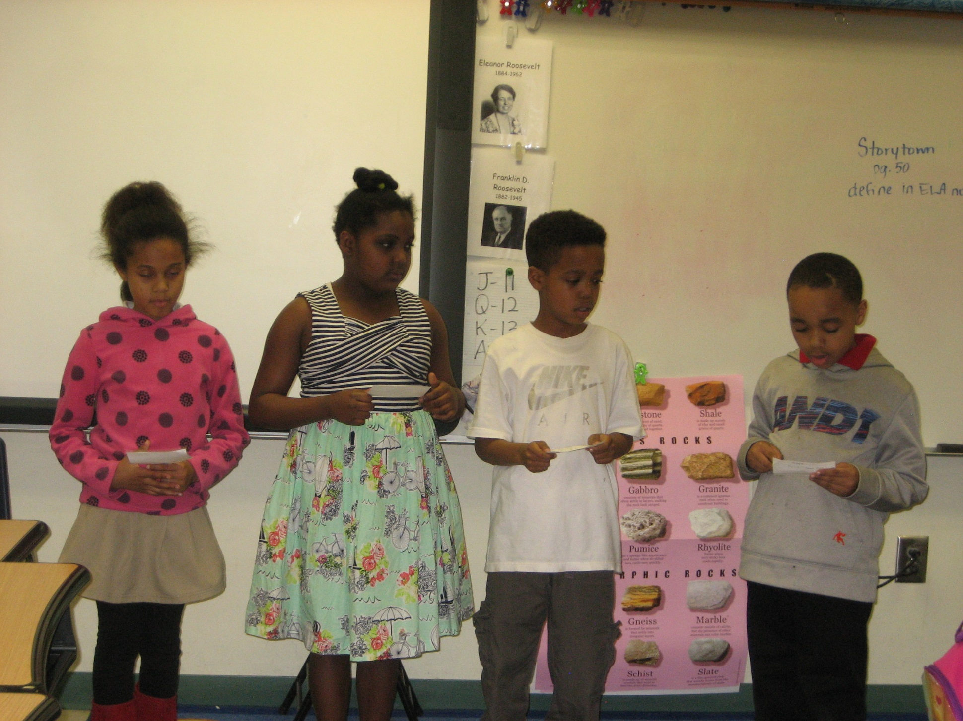
Present

Slide 8
Resources
https://eo.ucar.edu/kids/wwe/ground4.htm
2. http://www3.epa.gov/safewater/kids/flash/flash_aquifer.html
3. http://www.aquariumofpacific.org/downloads/IAFTM_AquiferLesson.pdf

Slide 9
Rubric

