Slide 1
Smart
Thinkers
Educate future
Mathematicians
DESTINY SWINNEY,TANIYA ALLEN, AMANI HOLLIS AND DARIUS STRONG

Slide 2

ASK:
How does math correlate with our stem project?
What is an aquifer?
3. How does an aquifer clean water?
4. Why are we doing this project?
5. What is the project?
6 .Is Dr. Bolden really going to drink our water ?

Slide 3

Imagine
The possible solution is that we need to clean the lead out of the dirty water so we can have clean water for us to drink. For third world countries and for people in Flint, Michigan.

Slide 4
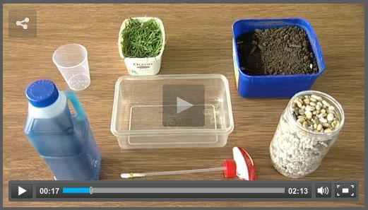
Materials
-clay
-grass
-dirt/soil
-pump
-container
-sandstone rocks
-gravel
-sand

Slide 5
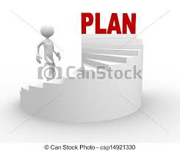
Plan
I imagine that we can first put the rocks in the container .
Then we can put the dirt in.
Put the grass in.
Put the water in.
Finally we put the spray bottle.

Slide 6
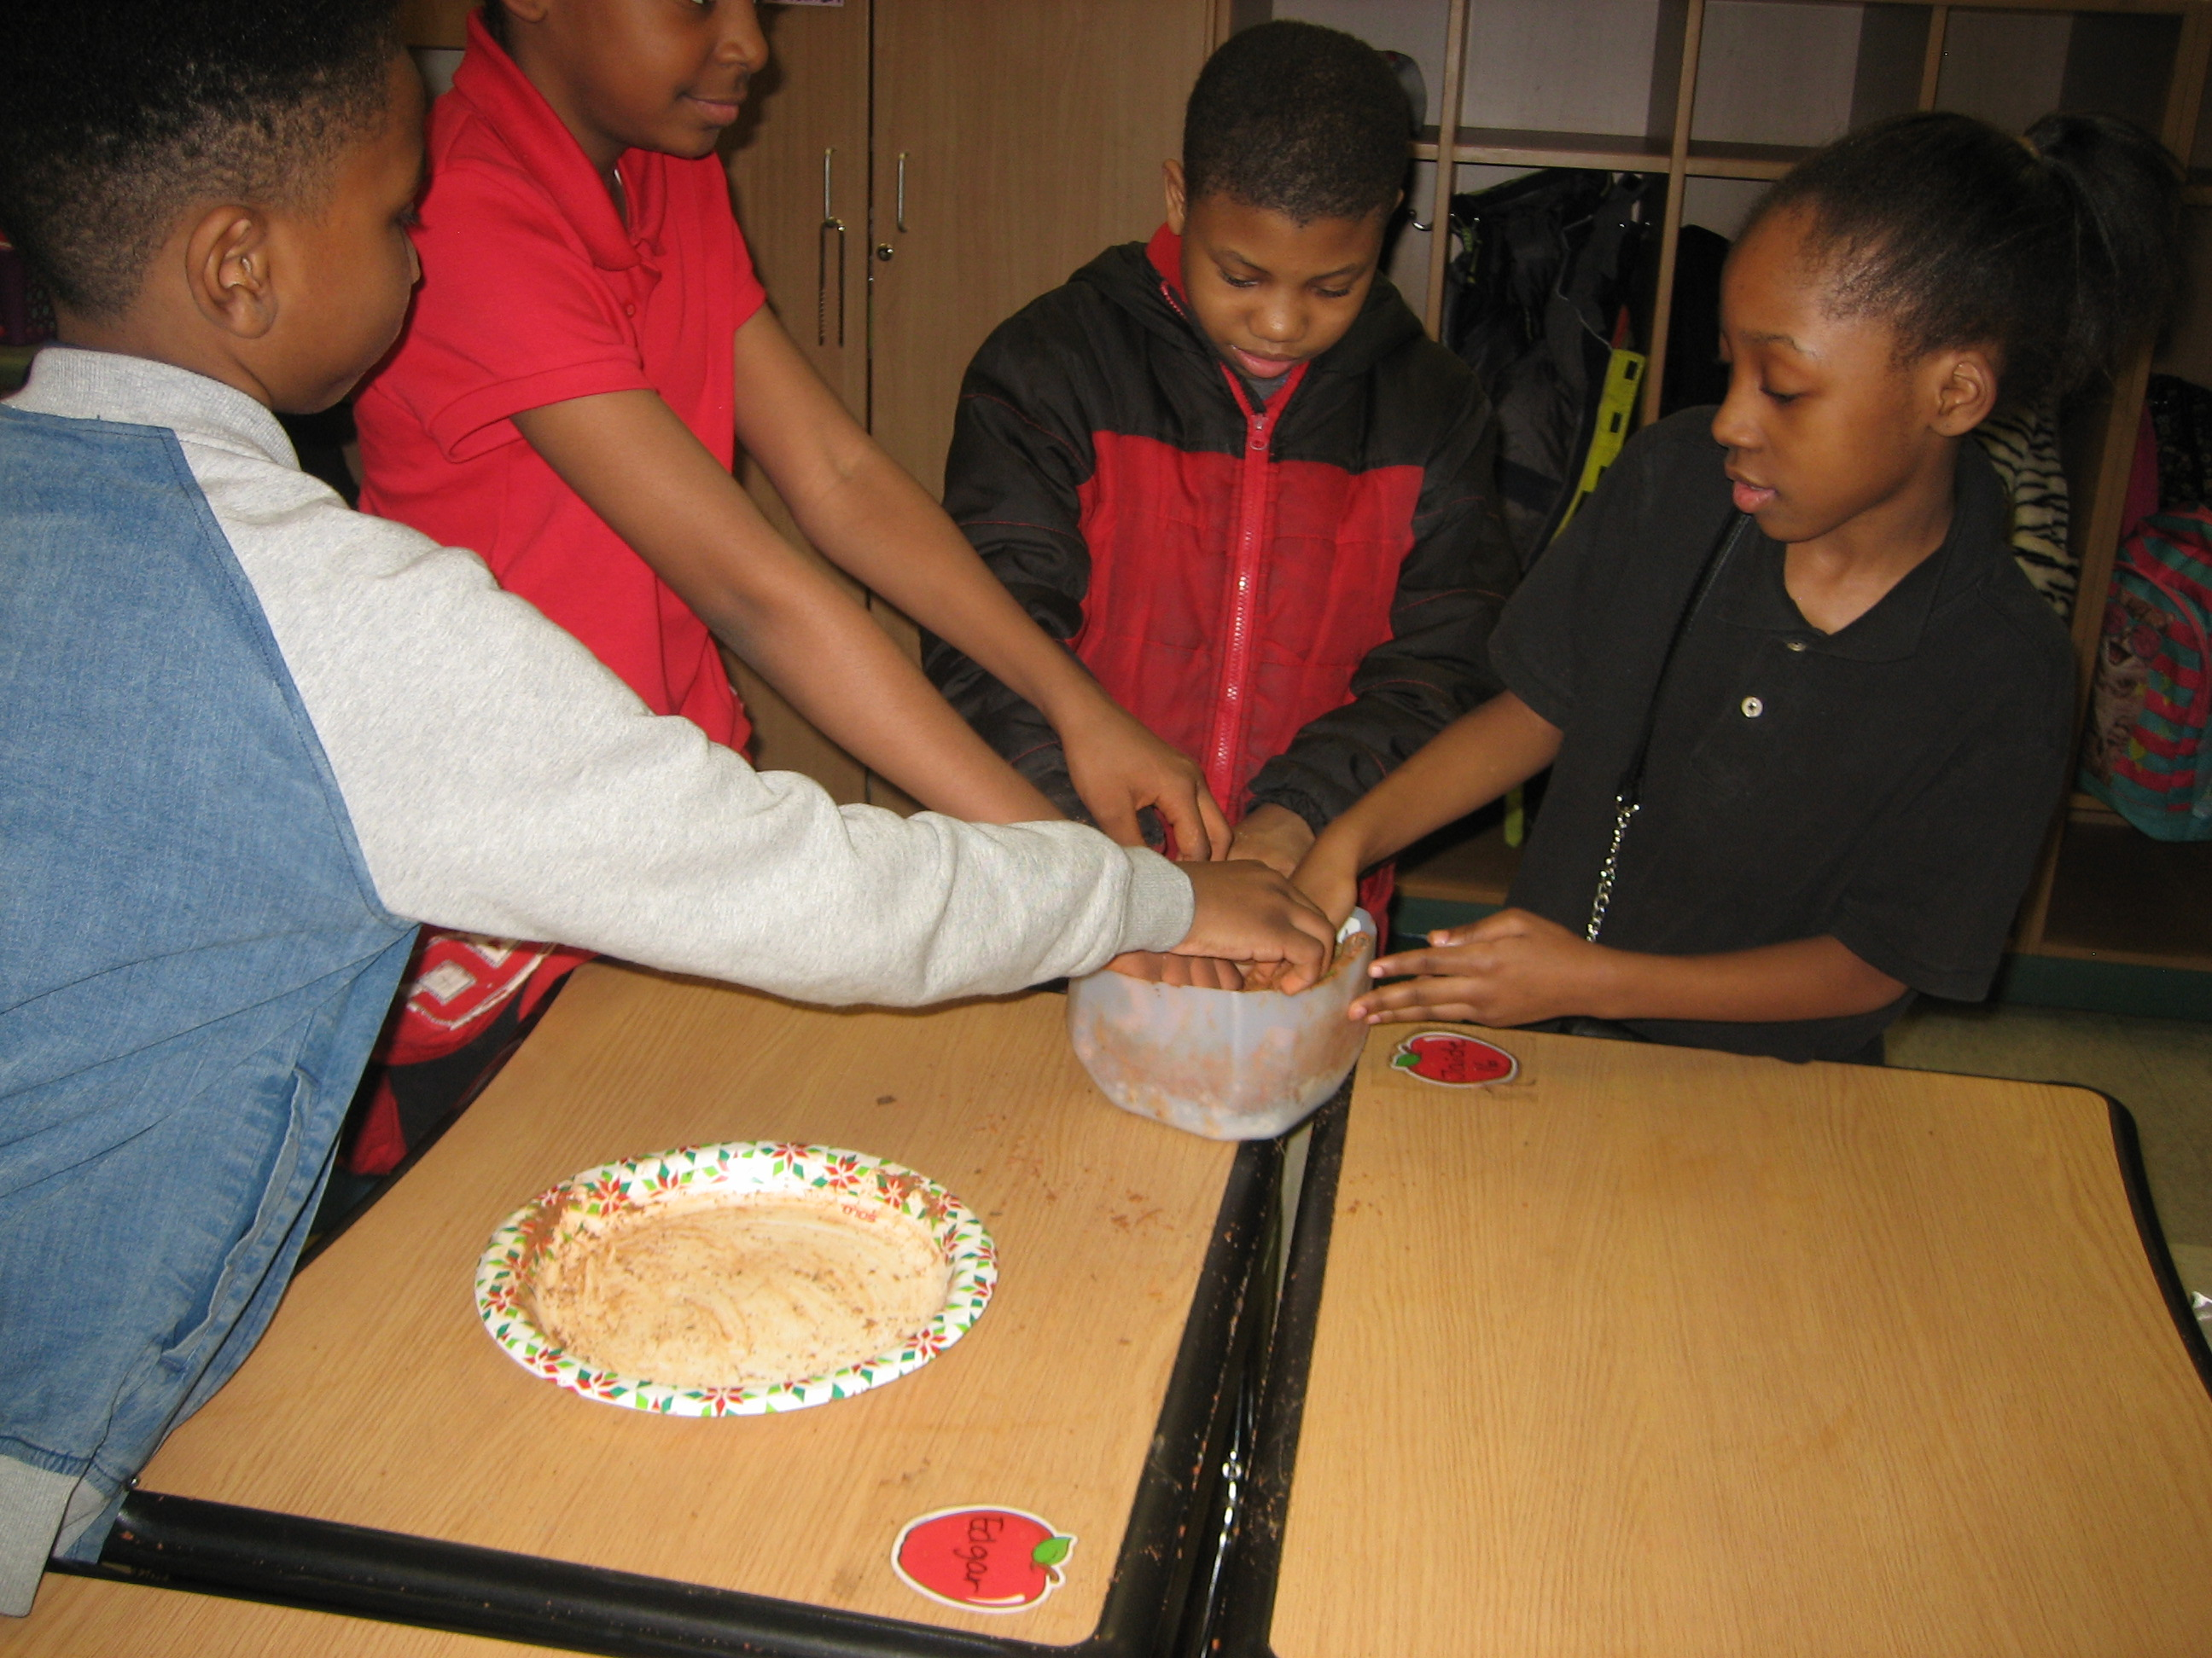
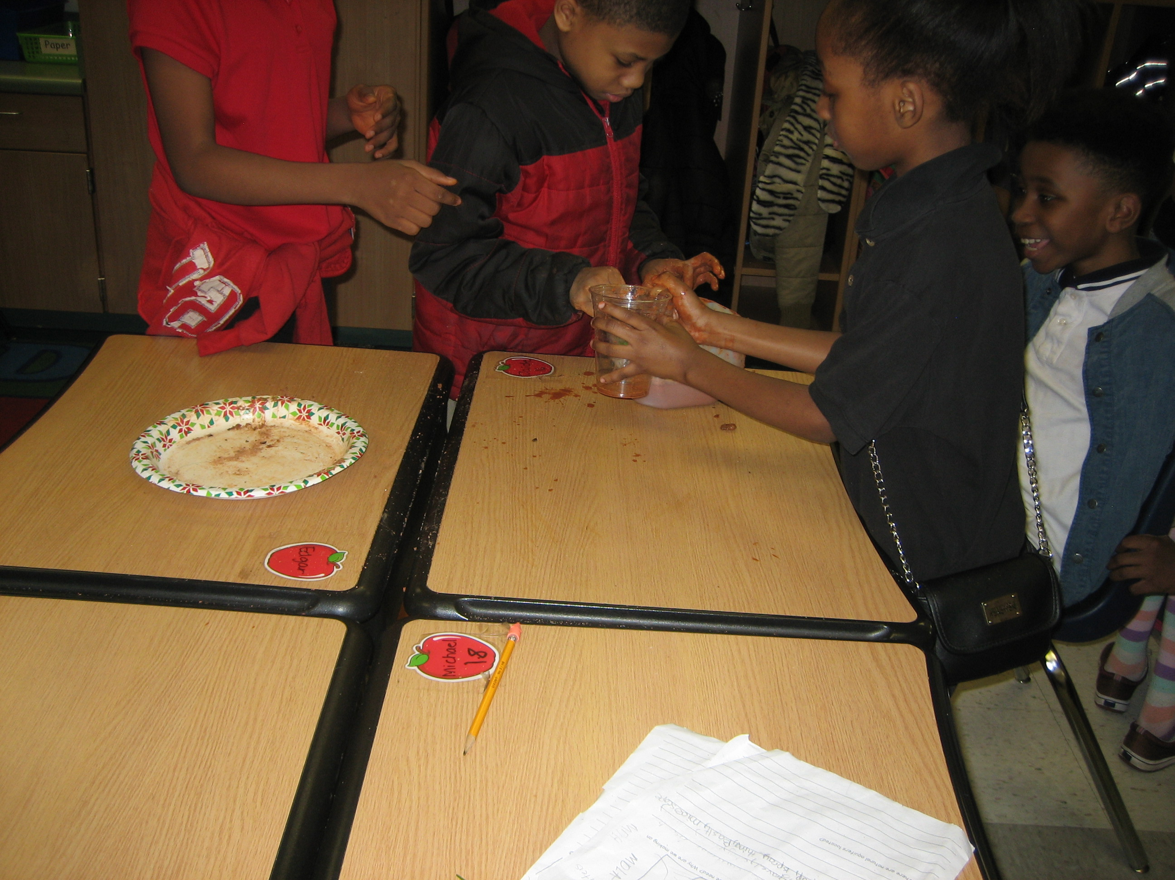
Create:

Slide 7
s
IMPROVE
1.We did not have a hill.
2.We did not pomp it right.
3.Did not have layers.
4.We had the wrong rocks
5. he had too much soil/dirt
6. We shouldn’t have mixed it

Slide 8
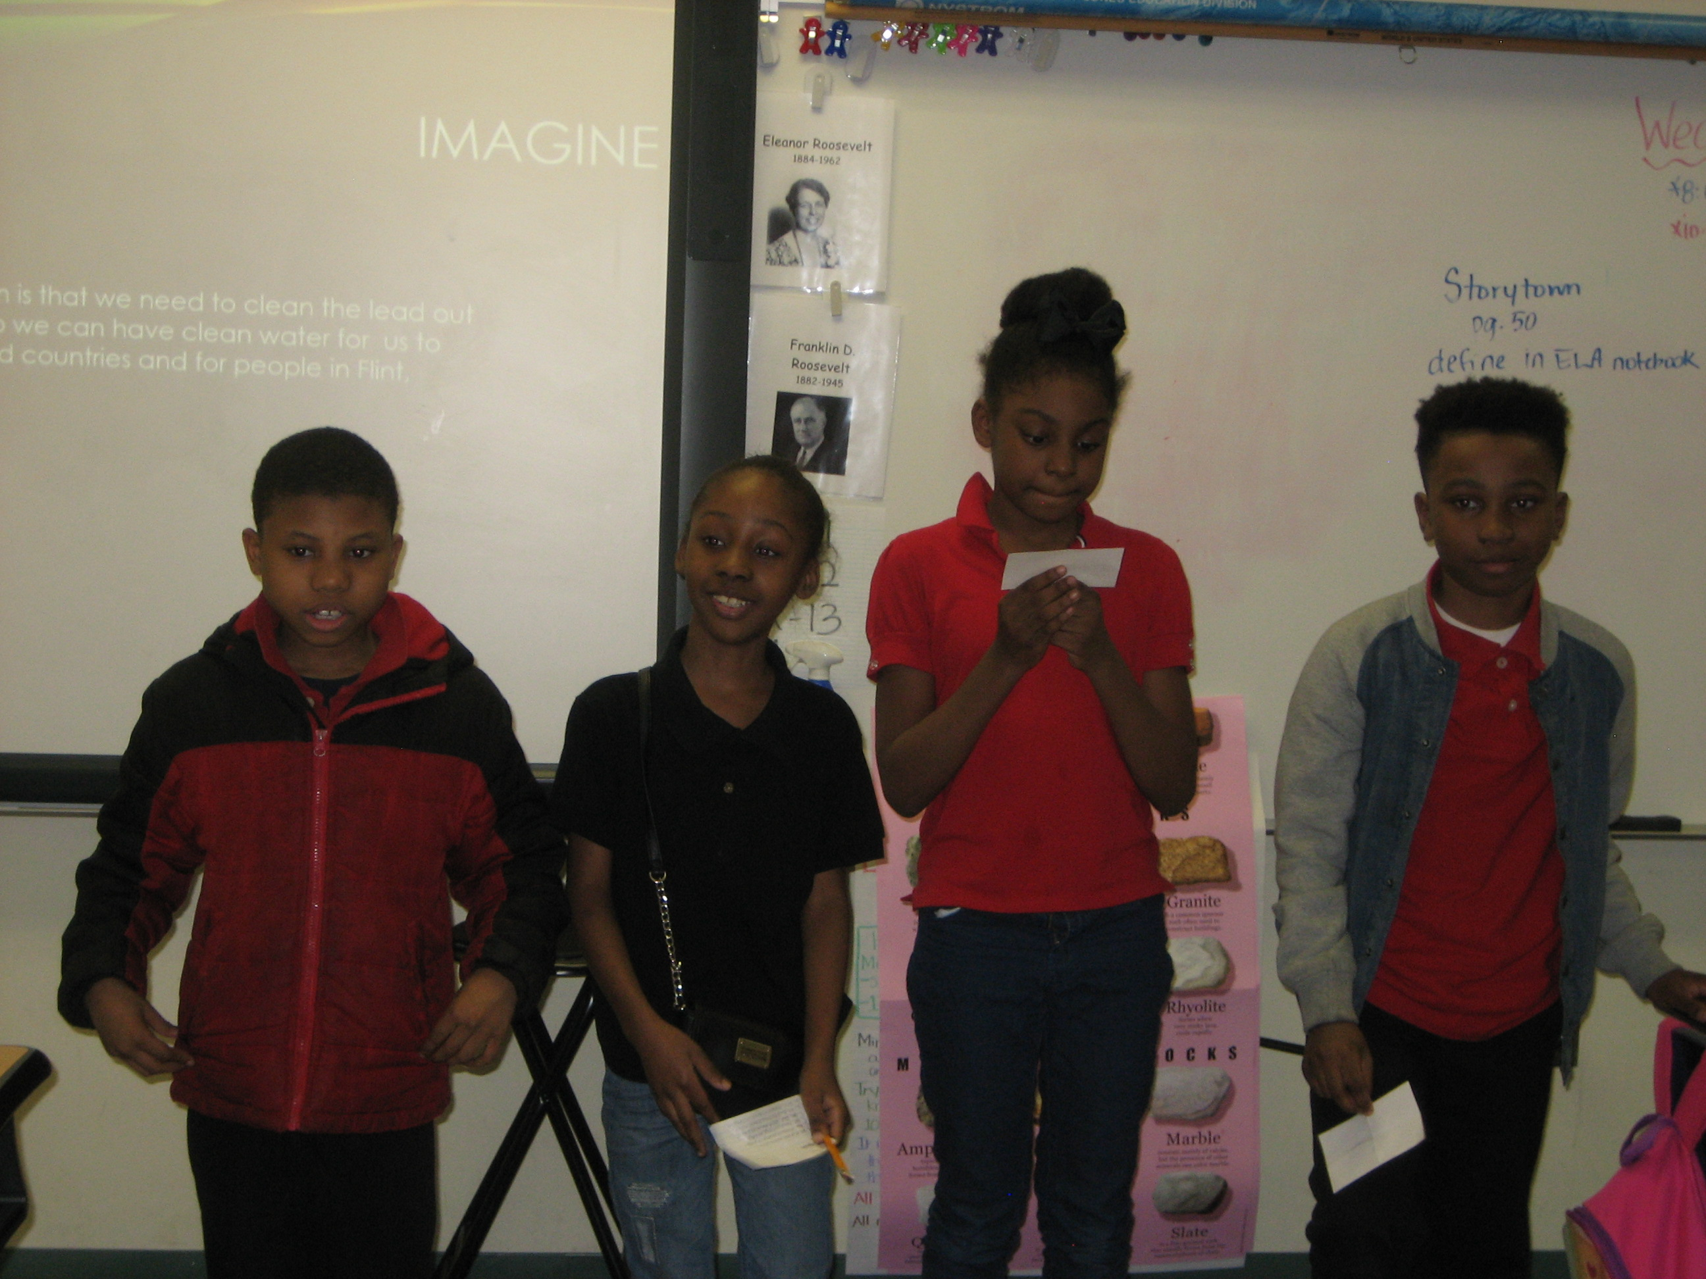
PRESENT

Slide 9
RESOURCES
1. http://sciencelearn.org.nz/Contexts/H2O-On-the-Go/Teaching-and-Learning-Approaches/Constructing-an-aquifer-model

Slide 10
RUBRIC

