Slide 1
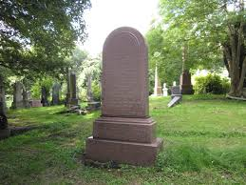
20 people die every day waiting for an organ transplant

Slide 2
We can tremendously lower this number if we have your support on our side

Slide 3
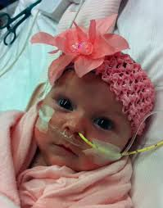
Without you this number will only get higher

Slide 4
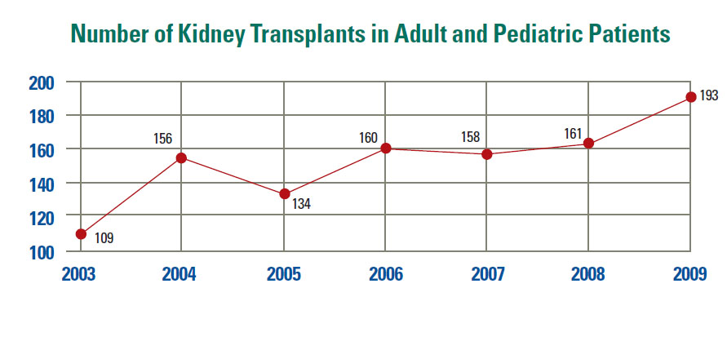
Within the last 10 years the number of people needing transplants has doubled

Slide 5
The number of transplants haven’t risen much

Slide 6
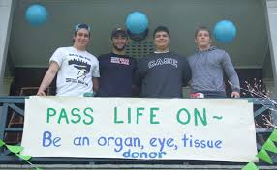
20 lives, in your hands , think about it

Slide 7
Please Support Cell Union

Slide 8
Contact Us
Website: www.cellunion.weebly.com
Phone: 678-875-3402

