Slide 1
20 people die everyday waiting for an organ transplant

Slide 2
Imagine living on a hospital bed waiting for an organ transplant but will never get one and possibly die

Slide 3
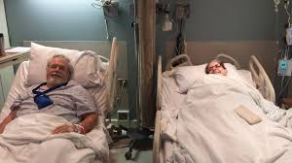
Notes:
May require more than one slide

Slide 4
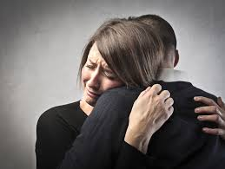
Imagine living free one day and then being in need for an organ transplant the next day

Slide 5
This could possibly be you, so take action now

Slide 6
Thank You
For more information please visit our website at:
www.communityorgans.weebly.com
Or contact us at 678-875-3402

