Slide 1
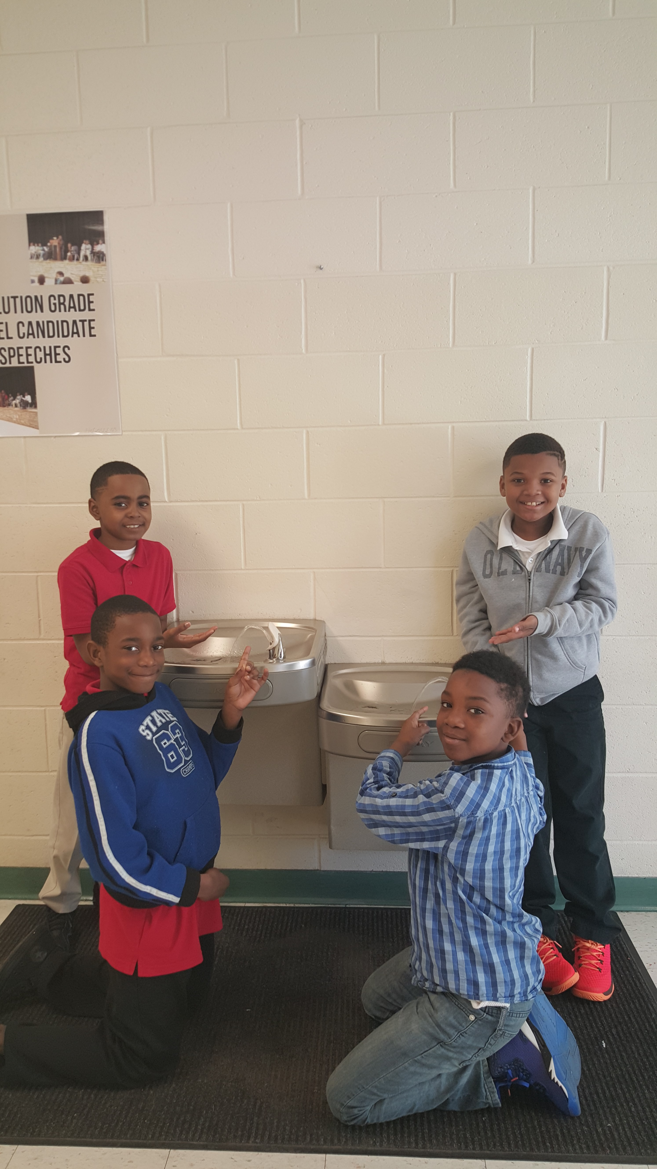
AQUIFER CONTROL CENTER
AQUIFER CONTROL CENTER makes you have a better dinner

Slide 2
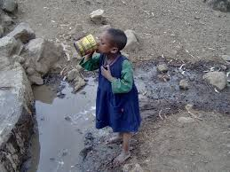
How can we help 3rd World countries?
We can help 3rd World countries by calling the Federal Government and asking them to help ship the aquifers to South America.
We can create a solution that can kill bacteria and make it safer for children to drink.

Slide 3
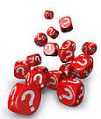
ASK
What are we using to make this filtration system? Omari Manuel
Why are we making an aquifer? Jeremiah Jackson
What natural items are we going to use? Kamari Smith
How will we know if it works? Jabari Floyd

Slide 4
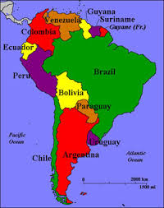
What’s the problem in Third World Countries
The problem in 3rd world countries they have to get water from rivers and the river water contains microscopic animals and bacteria which can harm you and give you diseases that are not curable.

Slide 5
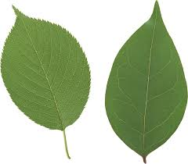
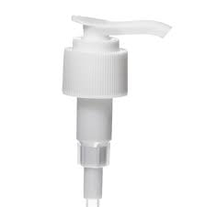
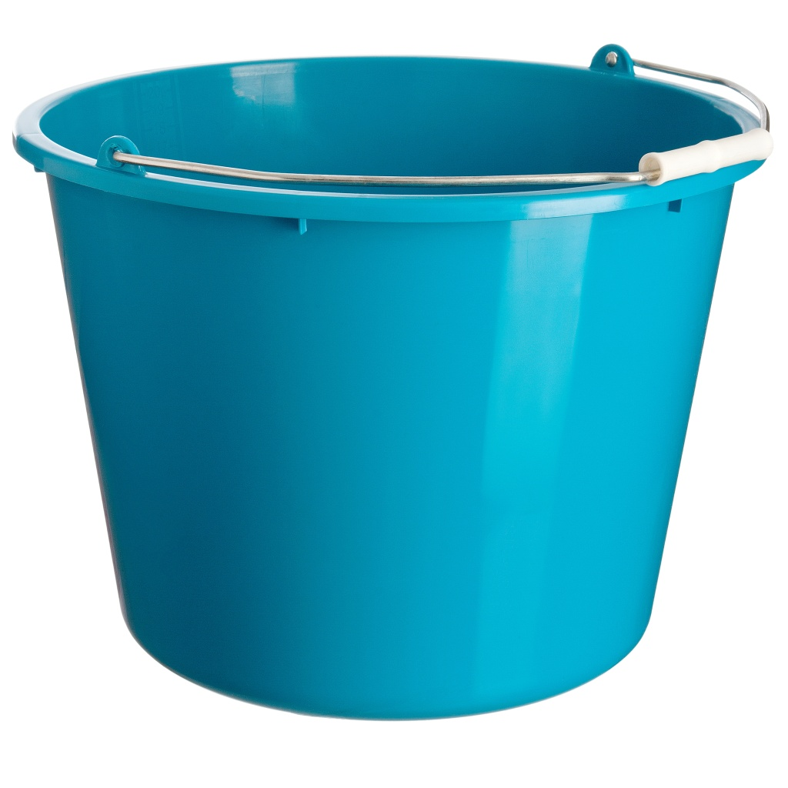
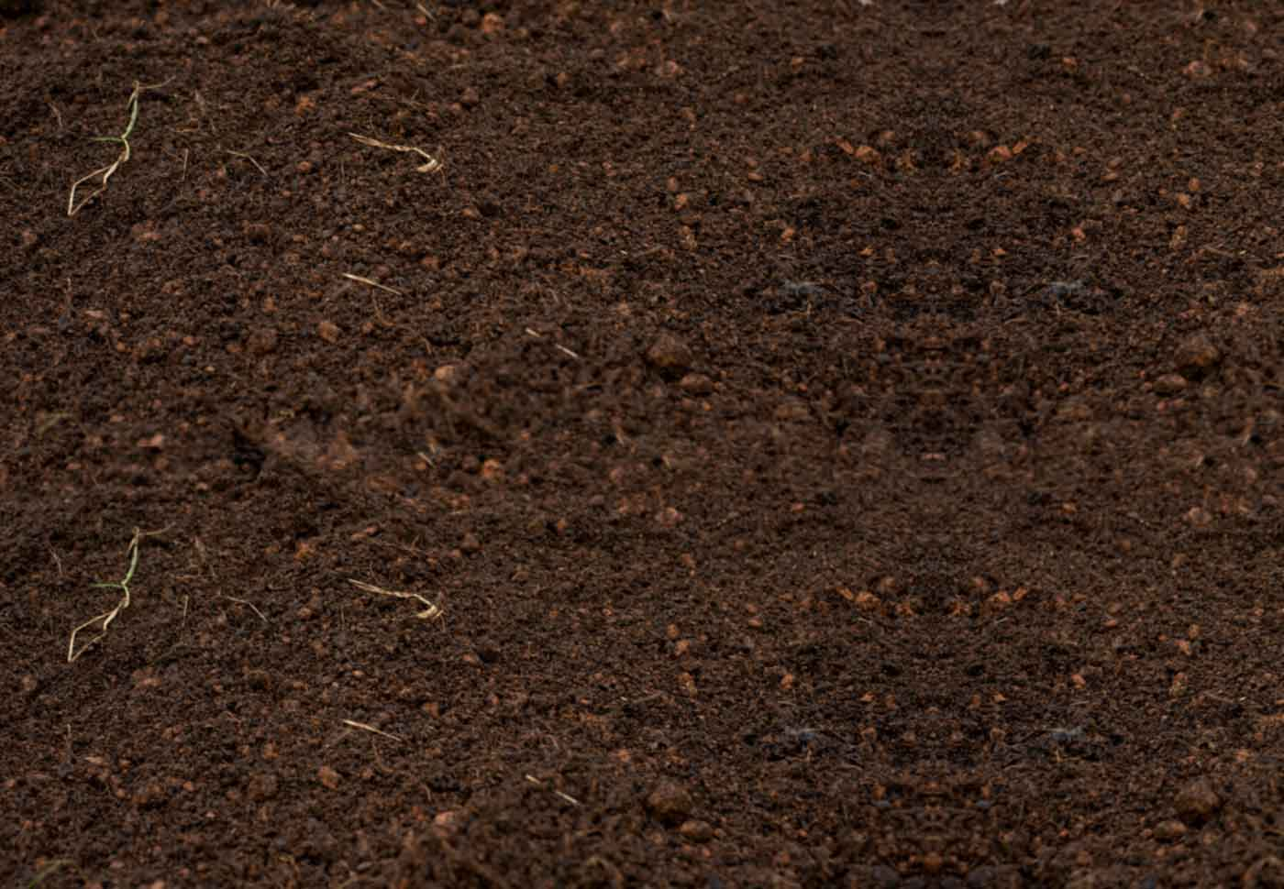
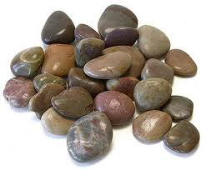
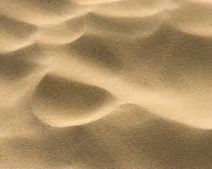
MATERIALS
We decided to use these material because we think that these will clean the water best. We picked soil and sand because when we did a science experiment sand and soil cleaned water the best. Our group used a soap dispenser because when I observed the soap bottle I saw that the soap dispenser pulled the soap out of the bottle.

Slide 6
Ways to kill bacteria
First we researched ways natural foods that can kill bacteria. We thought about how the solution would taste when we mixed them together because we wanted the kids to have water that taste good too!

Slide 7
What are some ways we can make money?
One way we can make money is that we will sell the filtration system for 2 dollars but the amount it takes to make it is 1 dollar.
We will earn 1 dollar per filtration system.

