Slide 1
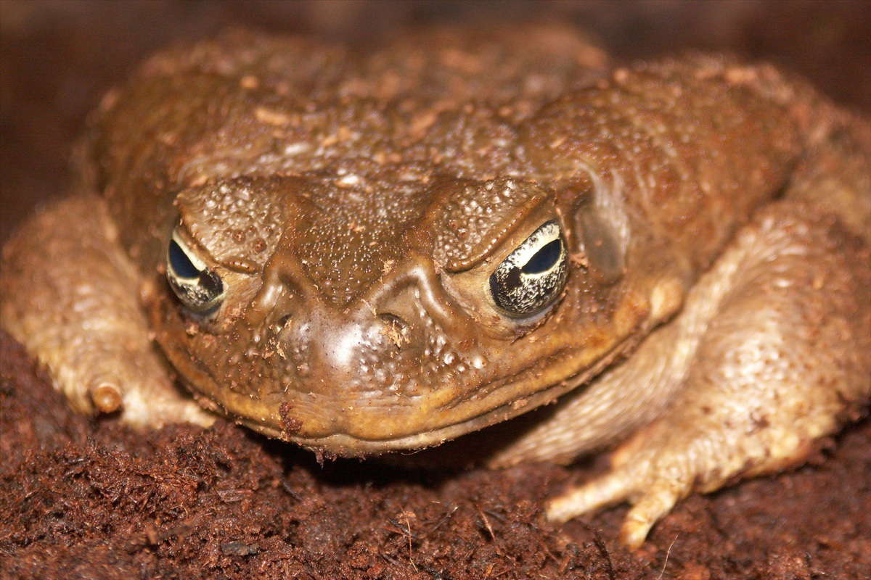
Cane toads
By: tRINITY hOOD & demiah gunn

Slide 2
Cane toad classification
Cane toad classification
Species: marina genus: rhinella family: bufonidae order: anura phylum: amphibian kingdom: Animalia

Slide 3
Facts about the cane toad
The cane toad skin has servel bumps the length of the cane toad is the same as a teaspoon the weight of the cane toad is 2.9 lbs cane toad eggs are laid in long strings the cane toad is native to both south America and central America

Slide 4
What is an invasive species
An invasive species is an organism that causes ecological or economic harm in a new environment where it is not native

Slide 5
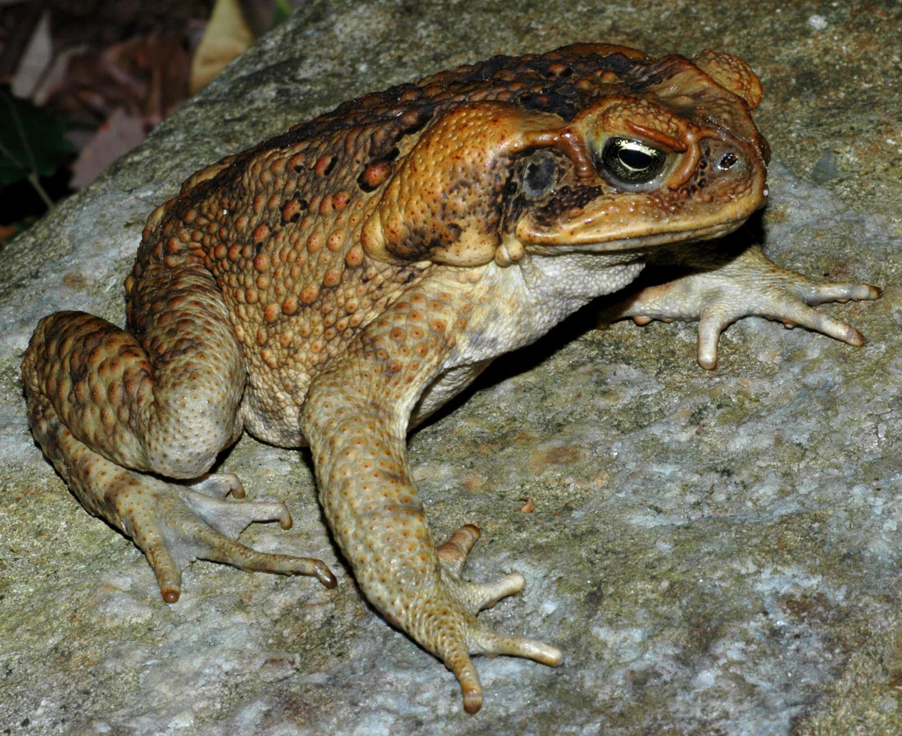
Pictures of the cane toad

