Slide 1
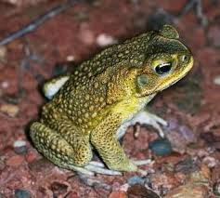
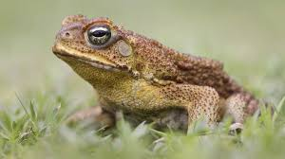
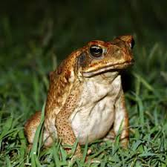
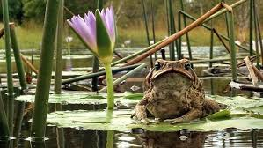
Cane toad
A presentation made by Da’Martys Williams and Semora Lazenby on the cane toad.

Slide 2
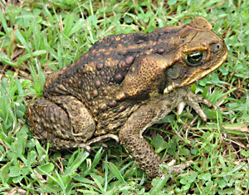
What is a cane toad???
A cane toad is a large brown toad. Its been introduced elsewhere as an invasive species or a pest agent but this toad can become a serious pest partly because animals that eat it are killed by the toxins that are in the Cane Toad.

Slide 3
BASIC FACTS ABOUT THE CANE TOAD
A cane toad has a lifespan of 5 to 10 years in the wild.
A cane toad is a omnivore they only eat plants and meat.
cane toad are a mix of toxins that primarily effect the functions of the heart.
The cane toad is 3.9 to 5.9 inches( adult to snout to vent).
Cane toads have poison that can kill the animals that try to eat them.
These toads are active at night which means they are nocturnal.

Slide 4
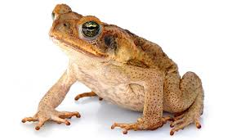
How is the Cane Toad an invasive species??
The Cane Toad is an invasive species because its from Hawaii and not Georgia. This animal has invaded Australia and Georgia and we have to stop it because its dangerous.

Slide 5
How is the cane toad changing the environment?
The cane toad is changing the environment because the females are having babies and reproducing. By them doing this they decrease the population of animals in the Okefenokee Swamp. They also increase the population because scene the female cane toads are reproducing they are increasing because the have babies and the are decreasing the population . In conclusion the Cane toads are incensing the population and decreasing the population

Slide 6
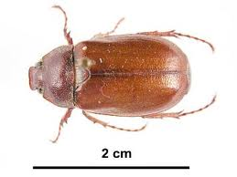
What do canes toads eat?
Cane Toads eat almost anything they can swallow, including pet food, carrion and household scraps, but most of their food is living insects. Beetles, honey bees, ants, winged termites, crickets and bugs are eaten in abundance. This just means they have plenty of food.

Slide 7
How are we going to stop the Cane toad from invading areas?
We can stop the cane toad from invading by making a habitat to make it look like its environment. Their environment looks like the Okefenokee Swamp, Grassland, and Freshwater. Next we can add some of their food to their environment to make it really feel like home because they have food to eat. After that we can add a small pool of water and camouflage it to really make it look like the Okefenokee swamp so they can really believe its really their home. After that we can add mechanic doors that shut when the cane toad comes in the trap, we can have two mechanic door and those will be a top door and a bottom door that close when the cane toad comes in its fake environment/ trap.
We can also stop the cane toad from invading areas by making a trap because we do not want the cane toads to invading any more areas in the united states because it took over the Okefenokee swamp and Australia and we are making this trap because we do not want to have any more babies and reproduce and killing more and more animals in the Okefenokee swamp.

