Slide 1
Work Smarter Not Harder: Clickers and Data
Presenter: Kaija Spencer
e20083169@dekalbschoolsga.org

Slide 2
Agenda
What are clickers? / clicker alternatives
How clickers support TKEYS
Effective use of clickers in the classroom
Different uses and methods
Research
Question and Answer

Slide 3
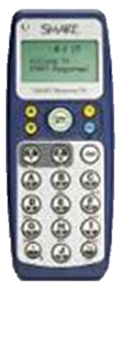
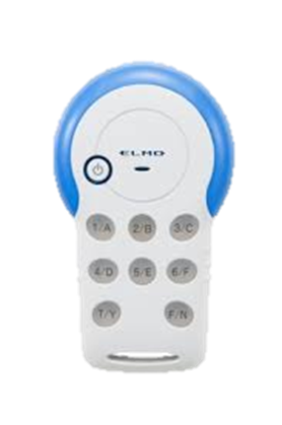
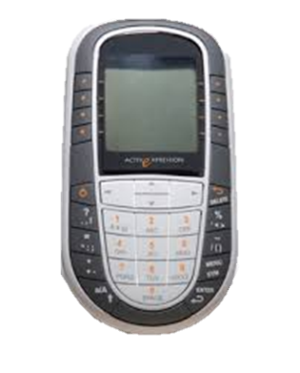
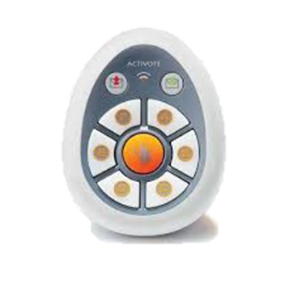
What are Clickers?
Any portable handheld devices that allows instant feedback to questions pose to an audience.
Which includes IOS and Android apps for mobile devices and web-based sites.

Slide 4
Why?

Slide 5
Your Turn!
Please login and answer questions 1 and 2

Slide 6
How can Clickers support TKES

Slide 7
TKES Standard 3: Instructional Strategies The teacher promotes student learning by using research-based instructional strategies relevant to the content to engage students in active learning and to facilitate the students’ acquisition of key knowledge and skills.
Recall
Conceptual Understanding
Application
Critical thinking
Student Perspective
Confidence Level
Monitoring
Utilizes research-based strategies and resources:
Questioning – planned and purposeful, use open and closed questions, use wait time, high and low-level (factual, inferential, evaluative) questions, follow-up questions (How did you know that?), conduct research and surveys

Slide 8
TKES Standard 3: Instructional Strategies The teacher promotes student learning by using research-based instructional strategies relevant to the content to engage students in active learning and to facilitate the students’ acquisition of key knowledge and skills.
Utilizes research-based strategies and resources:
Giving Feedback – be affirming, informative, guiding, descriptive, evaluative, verbal and non-verbal, spoken and written
Discuss Responses
Charts
Reports
Device Response
Conferences (with student or parent)

Slide 9
TKES Standard 5: Assessment Strategies The teacher systematically chooses a variety of diagnostic, formative, and summative assessment strategies and instruments that are valid and appropriate for the content and student population.
The expectations of a data driven classroom…
Aligns assessments with the curriculum
Uses diagnostic assessments to ascertain students’ strengths, weaknesses, knowledge, or skills
Uses formative assessments to adjust and modify teaching practices
Uses summative assessments to determine student attainment of the standards
Sets goals with students
Monitors progress of students

Slide 10
Your Turn!
Answer question
3

Slide 11
Types of Assessments and Results
Multiple Choice
True/False or Yes/No
Likert scale
Numerical
Textual

Slide 12
Your Turn!
Create a questions that supports your content using every type of test question.

Slide 13
Your Turn!
Answer question 4

Slide 14
How do I get started?

Slide 15
Tools for using Student Response Devices
Hardware and software
Promethean
Elmo
SMART technologies
Apps
Free
Subscription required

Slide 16
Reminder of Why ?

Slide 17
References and Research to Support the use of Clickers
National Education Association
Clickers and Classroom Dynamics
By Derek Bruff, Vanderbilt University
http://www.nea.org/home/34690.htm
Educause Learning Initiative
https://net.educause.edu/ir/library/pdf/ELI7002.pdf
Education World Connecting Educators to What works
http://www.educationworld.com/a_admin/admin/admin620.shtml
Education Week
http://www.edweek.org/dd/articles/2009/06/17/04feedback.h02.html
Engaging Technologies
http://www.engaging-technologies.com/classroom-clickers.html

Slide 18
Your Turn!
Answer question
5 - 9

