Slide 1
Anchor Charts
December 8th, 2015
Ronald E. McNair Discovery Learning Academy

Slide 2
What is an Anchor Chart?
Standards Based
Used for Reference by Students
Used to Support Instruction & Move Students Towards Achieving Success w/Lessons Taught
When is an Anchor Chart created?
During instructional time
As the teacher models the lesson or strategy, the lesson reinforcement or strategy tool is written on chart paper.
After
Placed in a convenient student-friendly location so that the students can access it independently

Slide 3
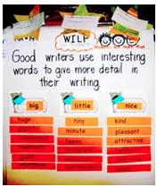
Anchor Charts: 5 Essential Features
Should have a SINGLE focus
"Students will write with a clear focus,
coherent organization, and
sufficient detail."

Slide 4
Anchor Charts: 5 Essential Features
Co-constructed with students.
Brain based learning strategies, support the use of visuals to incorporate new learning into memory.
The anchor chart is organized.
Clarity is paramount to understanding.

Slide 5
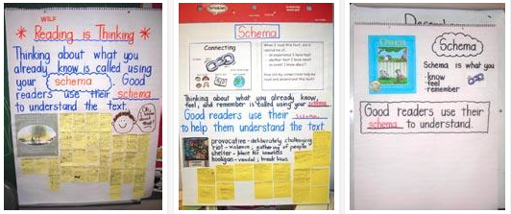
Anchor Charts: 5 Essential Features
The anchor chart matches the learner’s
developmental level.

Slide 6
Anchor Charts: 5 Essential Features
The anchor chart supports on-going
learning.
One of the most important considerations is whether or not the chart is relevant and used by the students.

Slide 7
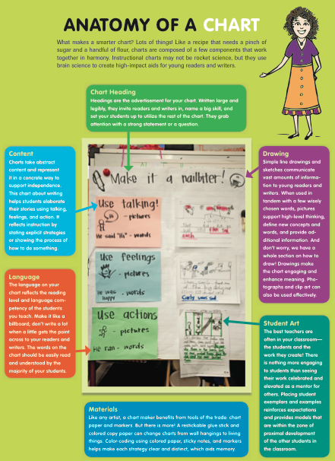
Anatomy of a Chart

Slide 8
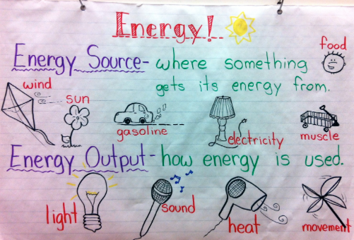
Examples
+ STANDARD

Slide 9
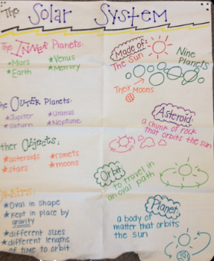
Examples
+ STANDARD

Slide 10
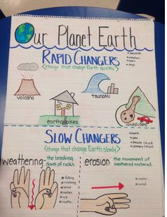
Examples
+ STANDARD

Slide 11
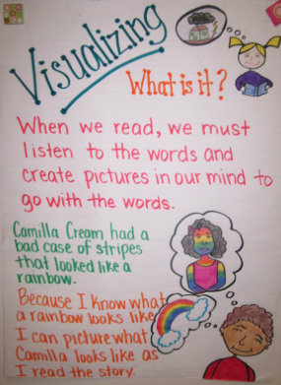
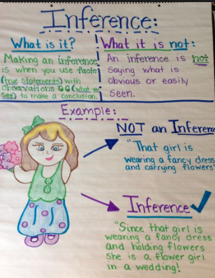
+ STANDARD

Slide 12
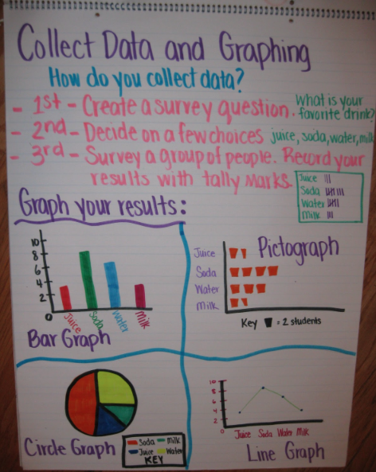
Examples
+ STANDARD
+ Student Portion

Slide 13
Look at the science standards you are about to teach (January-February)
Pick one science standard and create an anchor chart for this science standard

